Slide 1
The Next Generation of Marketing Leaders Summit 2023

Slide 2
Welcome!
David Cowan
Managing Director
The Financial Services Forum

Slide 3
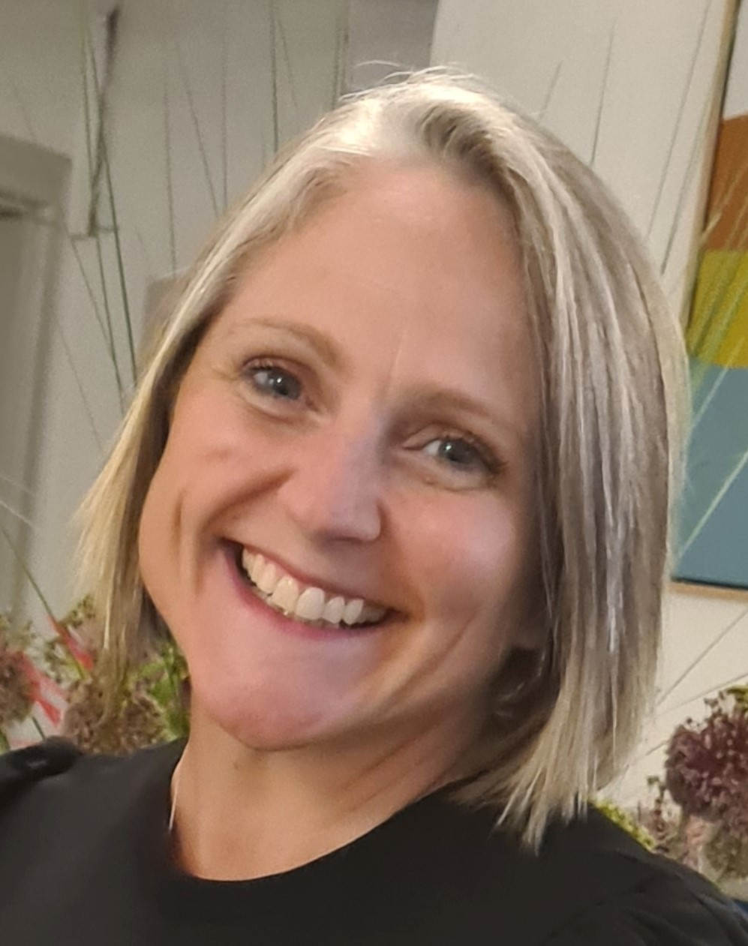
Meet The Forum Team
David Cowan
Managing Director
Alex Sword
Editor
Jasmine Butler
Marketing Manager
Gill Excell
Event Manager

Slide 4
Meet The Forum Team
Rubin Zajsi
Business and Sponsorship Lead
Tom Williams
Conference Producer
Zara Mughal
Senior Marketing Executive

Slide 5
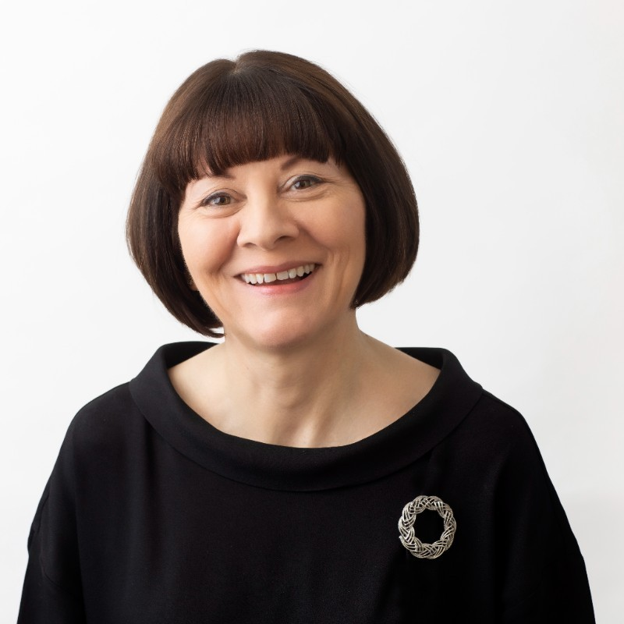
The Strategic Use of Social Media in Financial Services
Dr Annmarie Hanlon
Course Director, MSc Marketing and Leadership,
Cranfield School of Management

Slide 6
7 Strategic Uses of Social Media for Financial Services
Dr Annmarie Hanlon

Slide 7
Notes:
https://www.sjss.org.uk/events/national-symphony-orchestra-1

Slide 9
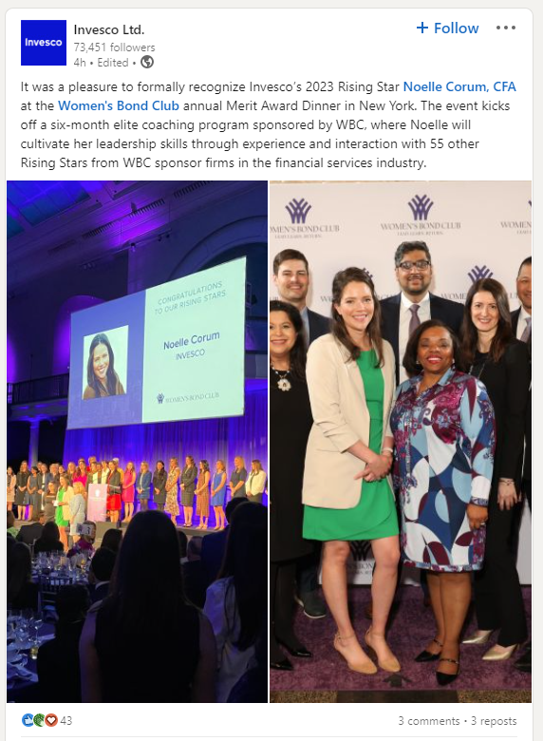
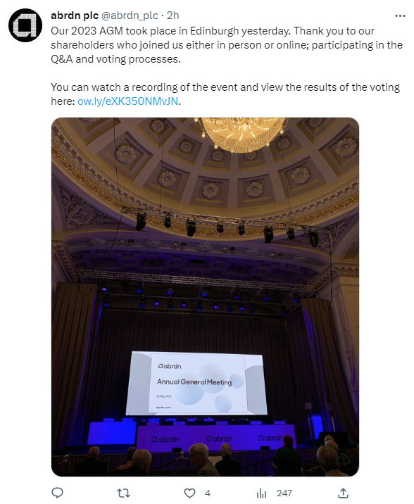
#1 - Engagement with customers in B2B

Slide 10
#2 - Entertainment

Slide 11
#3 - To provide offers and sales Part of lead generation

Slide 12
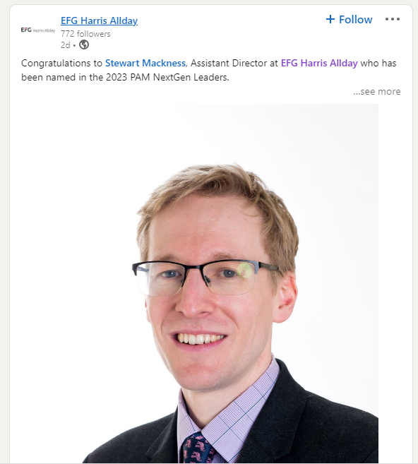
#4 - To gain reviews, testimonials, case studies

Slide 13
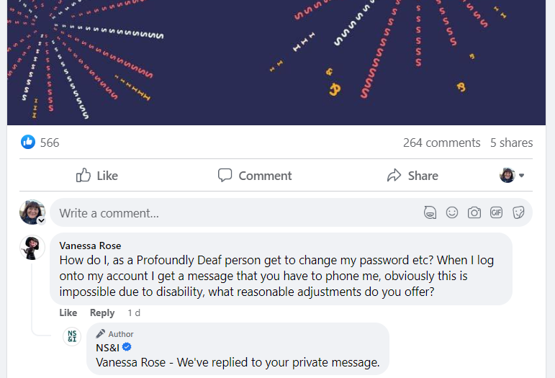
#5 - To deliver customer service

Slide 14
#6 - For customer segmentation Targeting specific groups

Slide 15
#7 - For brand management and awareness

Slide 16
7 Strategic Uses of Social Media for Financial Services
1. To interact with customers - engage
2. To entertain customers
3. To provide offers and sales
4. To gain reviews
5. To deliver customer service
6. For customer segmentation
7. For brand management and awareness

Slide 17
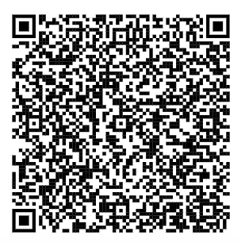
Final slide
Dr Annmarie Hanlon

Slide 18
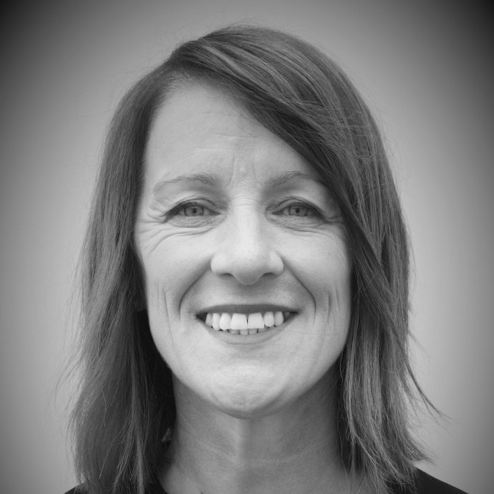
From Big Tech to Fintech: Journey Through Financial Services
Suzanne Homewood
Managing Director – Decisioning Division
Moneyhub

Slide 19
Suzanne Homewood
Managing Director, Decisioning

Slide 21
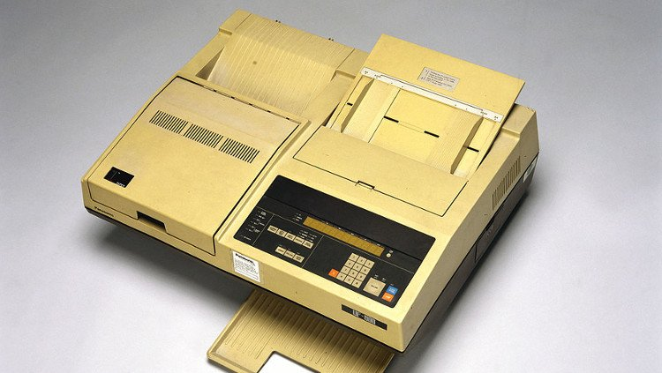
Technology……..

Slide 22
The mobile to data revolution

Slide 25
2014 - 2023
Our Vision:
To enhance the lifetime financial wellness
of people, their communities and
their businesses

Slide 26
Growth trajectory…
£55m investment

Slide 27
What’s Next? Post investment

Slide 28
Why Open Finance now?
7m

Slide 29
Financial worries
55% uk adult population afraid to talk about their financial situation
79% using some form of credit facility

Slide 30
19bn
In unclaimed financial support each year

Slide 31
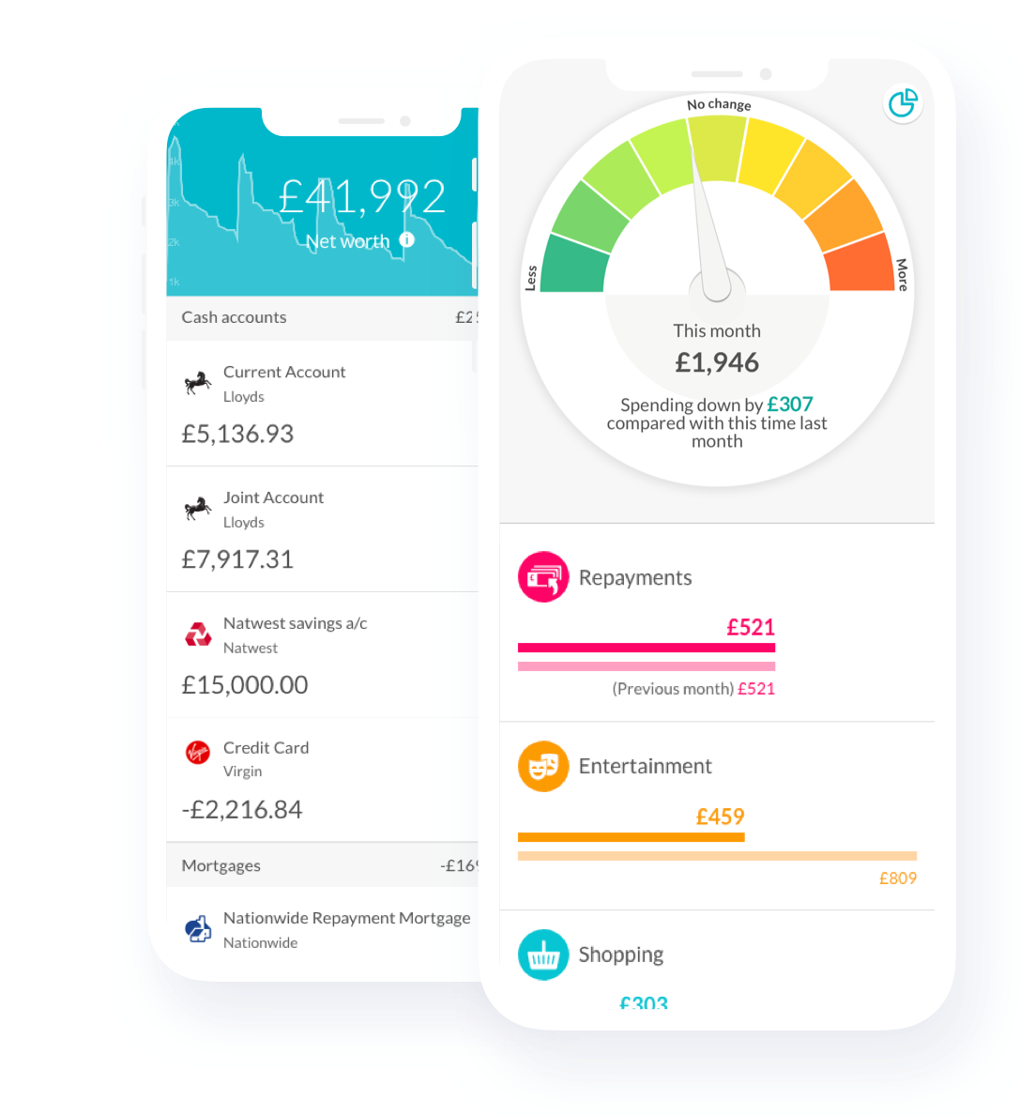
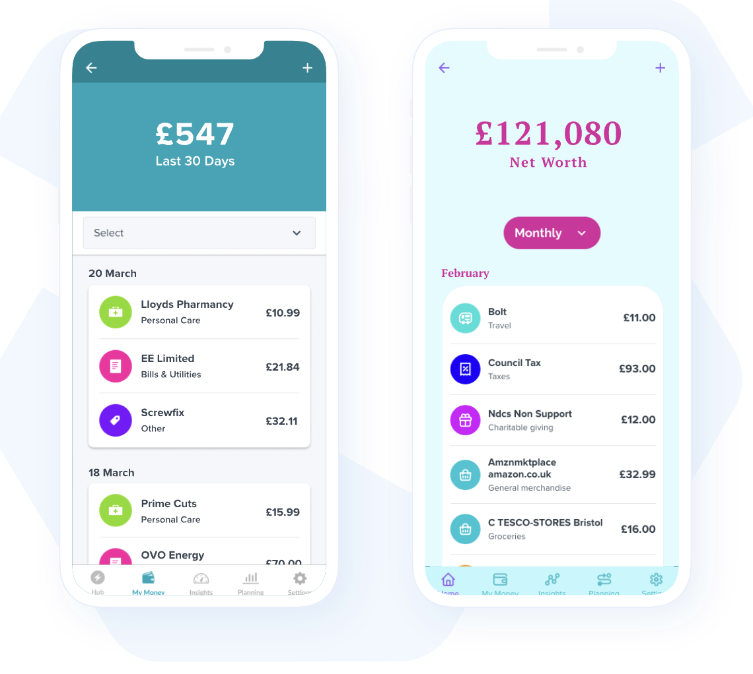
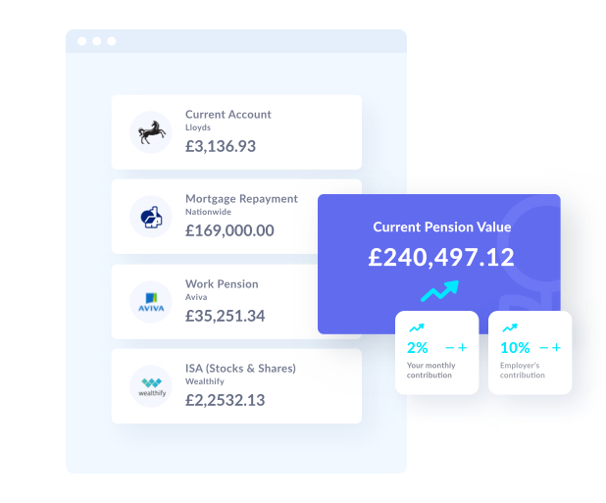
Moneyhub Helping businesses through intelligent data insight

Slide 32
Real time insights
Mortgages tripled Cost based on a £250k mortgage
Saving capacity has eroded Average UK household net-income
Shopping behaviour has changed Shopping at budget supermarkets is up:
~£31,000
12%
3x
6%
£1,250
Savings down 14%
6%
2.1%
£417
~£26,000
6%
Savings down 9%
0%
June 2018
In deficit
-13%
2022
July 7%
December 4%
Source: Moneyhub
Notes:
TALK TRACK/SPEAKER NOTES
Mortgage rates have tripled since June 2018 up from 2.1% to 6%. This means a mortgage of £250,000, now costs £1,250 compared to £416.67 in June 2018.
According to MH data
We can see that typical saving capacity has eroded:
A typical U.K. household with a net-income of ~£31k saving capacity has declined from 14% in October 2021 to 6% in October 2022.
Lower income U.K. household with a net-income of ~£26k saving capacity has declined from 9% in October 2021 to 0% in October 2022. In fact, lower income households had to borrow or use up savings to cover a deficit of 7% of their net income in July 2022 and 4% in August 2022 to cover spending.
Our MH data also shows a change in consumer shopping behaviour. We can see our users are moving towards budget supermarkets to reduce the impact of price rices. When looking at our data this October compared to last year (2021-10 vs 2022-10), shopping at budget retailers Iceland and Lidl is up at 12% and 6% respectively while shopping at Waitrose is down 13%
It is very clear, everybody but in particular, those most vulnerable and on low-income will be hit the hardest.

Slide 33
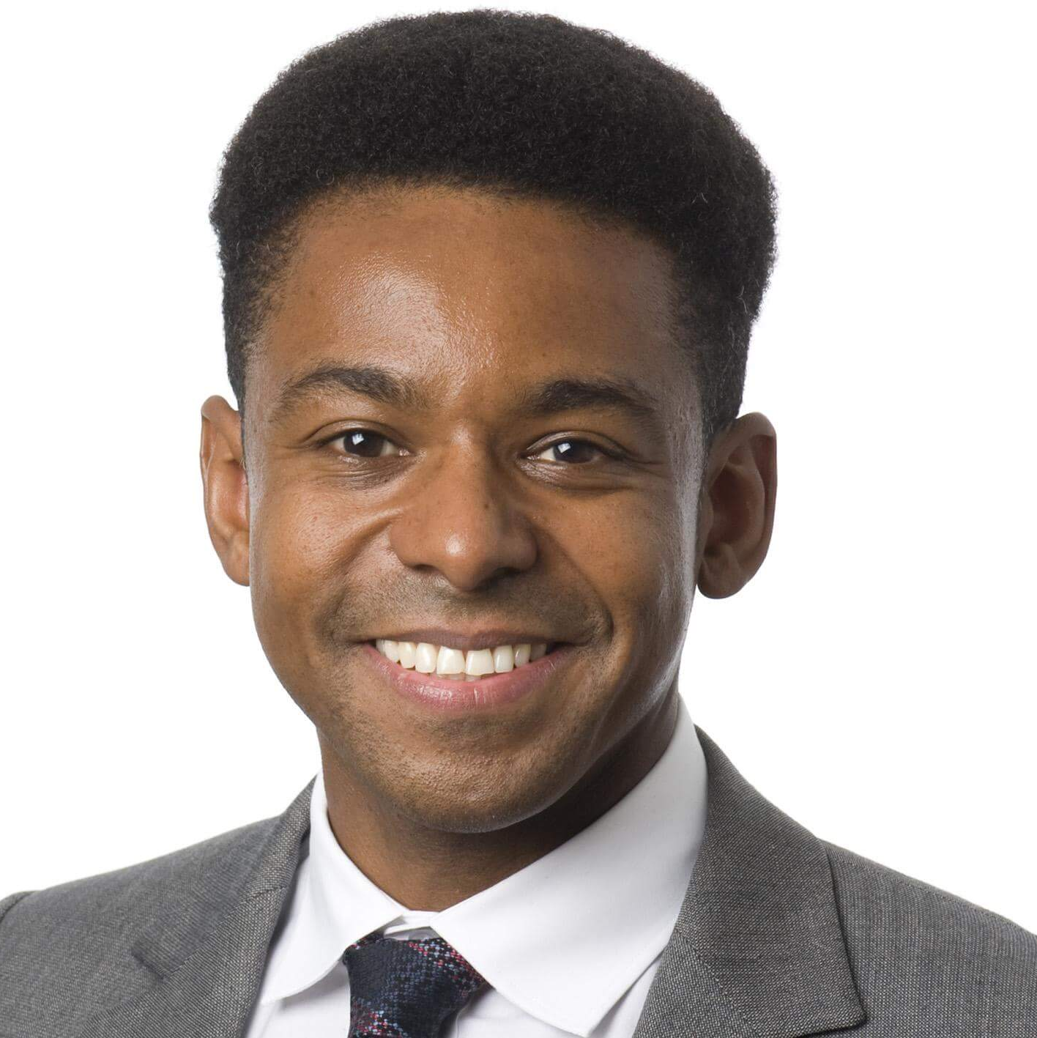
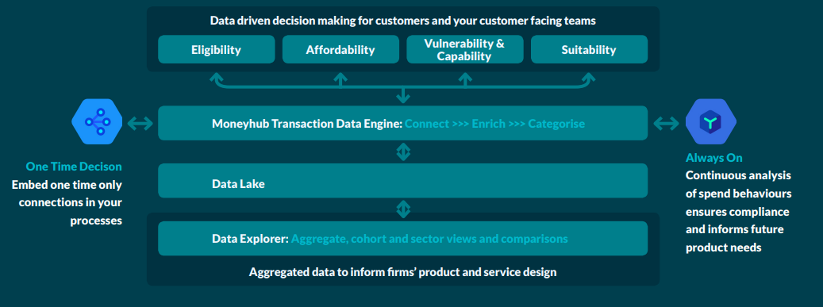
“Be in no doubt: the Duty will be a significant shift in what we expect of firms.”
Sheldon Mills – Executive Director, Consumers & Competition: FCA
29th September 2022 – Consumer Protection in Financial Services Summit
Notes:
Talk track
(The purpose of this slide is to set the scene and to plant the seed that done well, Consumer Duty is an opportunity for firms, that it relies on putting data at the heart of the response, and that whilst it’s daunting, Moneyhub is here to help)
The purpose of this presentation is to talk about Consumer Duty as a business opportunity
And how Moneyhub can help you comply with the Consumer Duty whilst also helping grow your revenues, reduce costs and improve risk management
The FCA’s vision for Consumer Duty is that:
1. It provides a fairer basis for competition
2. The flexibility of an outcomes-focused, rather than prescriptive, approach
3. And a boost to growth and innovation
TAKEAWAY
If you take just one thing away from this presentation it’s that Consumer Duty is a significant shift, both for firms and for the FCA. It is also an opportunity for firms
Don’t just take my word for it – these are the words of the FCA’s Sheldon Mills in his speech at the end of September.
This shift means putting customers in a position:
1. Where they can make informed decisions;
2. Where they are presented with suitable products and services for their individual needs;
3. Where they receive fair value for those purchases;
The duty will require all firms whether designing, manufacturing, distributing or advising on products and services, to put retail customers’ needs first
The question is how do you do this, and how do you create value from it?
I want to talk about
1. The win:win of consumer duty
2. The role of data in consumer duty compliance
3. And Moneyhub’s role in guiding you to the data you need

Slide 34
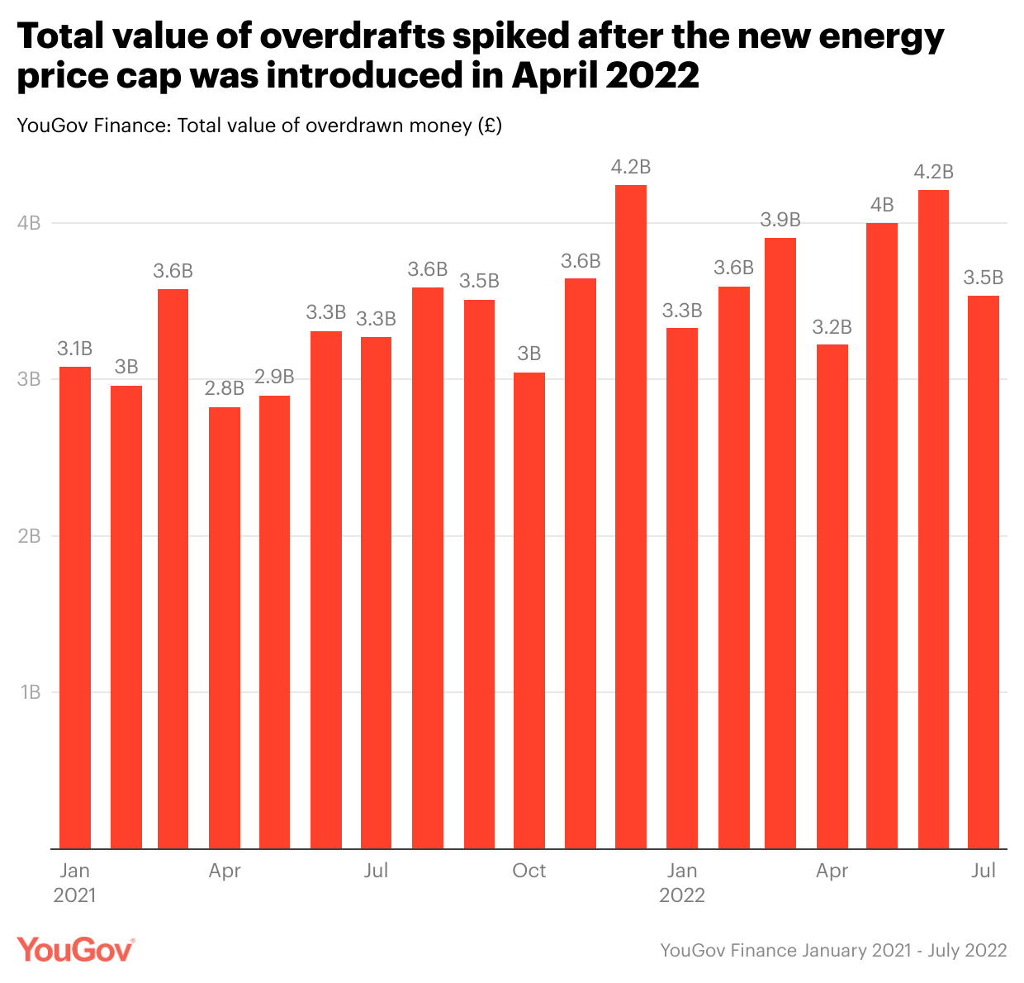
Financial worries
34%
of uk population has none, or less than £1000 in a savings account
£300bn
of savings are earning 0.1% or less

Slide 35
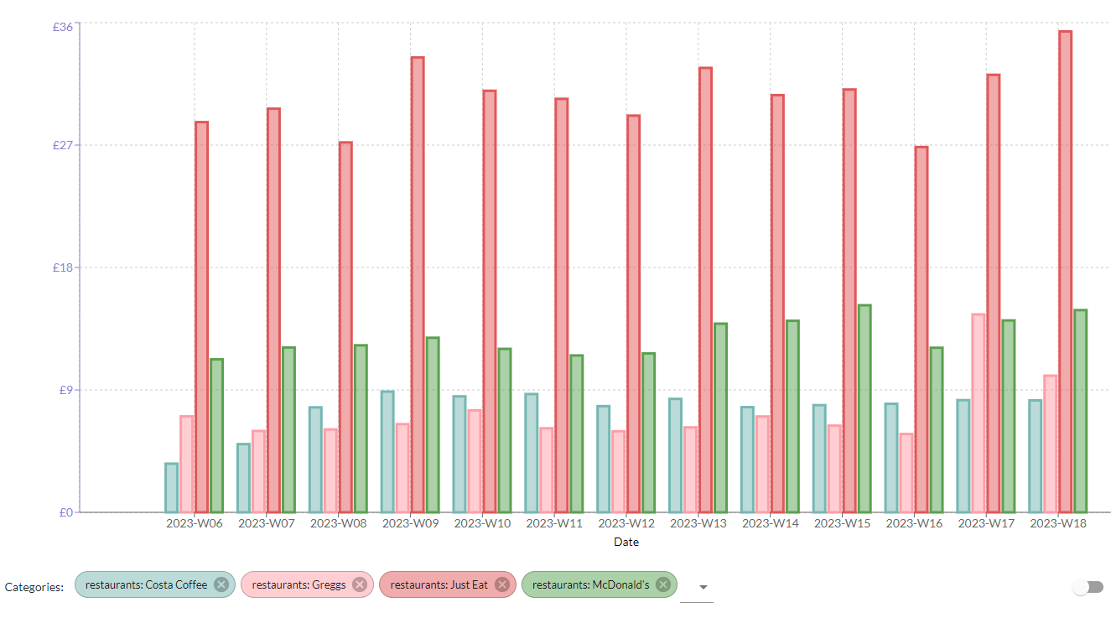
The power of data: Benefits the consumer and the business

Slide 36
According to McKinsey & Company, 71% of consumers expect companies to deliver personalised interactions and 76% get frustrated when this doesn't happen. Mckinsey's study also found that personalisation drives performance and better customer outcome October 2022

Slide 37
The power of data
70% of applicants happy to share their data
30% increase in acquisitions when using Open Banking powered decisioning
50% reduction in bad debt
There is a lot to be gained from Open Finance Data

Slide 38
Thank You
Try it for yourself

