Slide 1

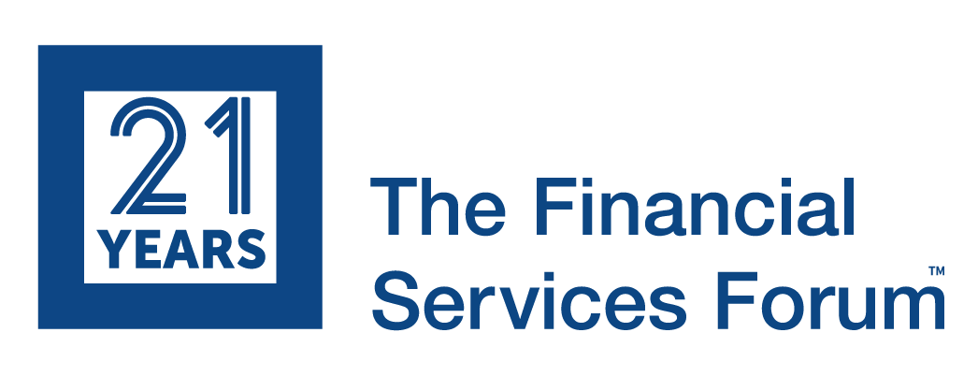
Lunch

Slide 2
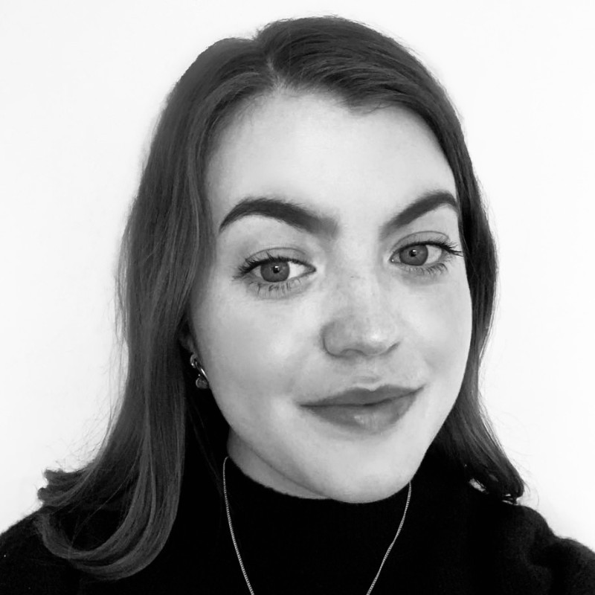
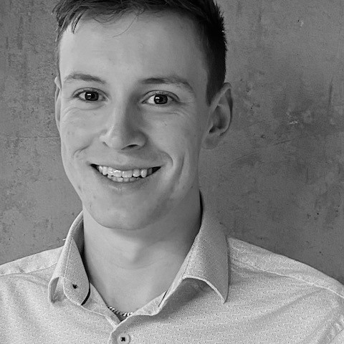

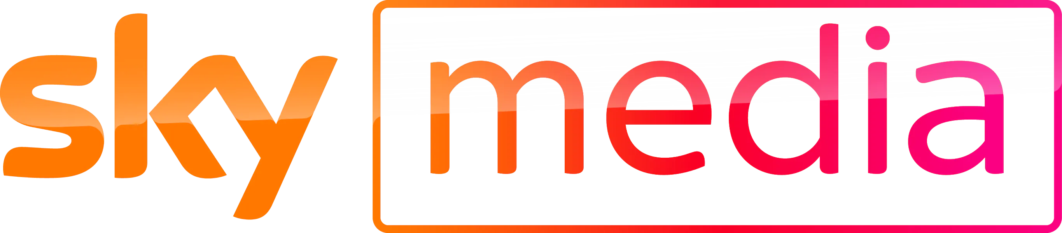

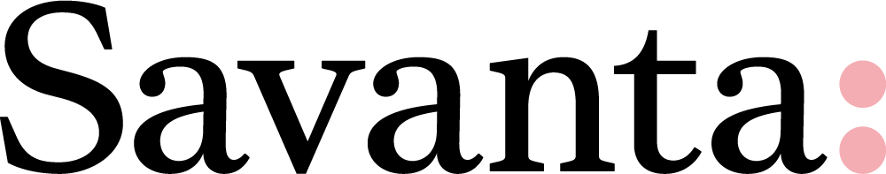
The Finances of the Younger Generation During Uncertainty
Lydia Daniels
Research Consultant
Savanta
Matt Thomas
Research Executive
Savanta

Slide 3




Future trends and opportunities:
The next generation
Matt Thomas & Lydia Daniel
savanta.com
make better decisions

Slide 4


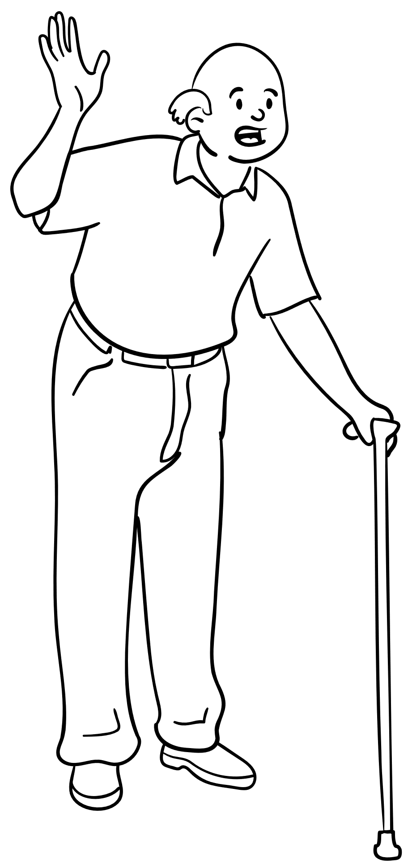
Who are…
We side hustle…
Care about our surroundings…
GEN
Lazy
Are globally connected…
Overindulged
…but isolated by Covid
Always complaining
?
And face a
scary and unaffordable future.
Age 11-26
Obsessed with TikTok
Notes:
Themes – engagement, trust, brand sentiments, ultimately customer acquisition / usage.

Slide 5
One thing’s for sure…
They care about their finances.
53%
Say that the cost-of-living crisis is a constant worry
58%
We’re in a difficult period for everyone right now, and Gen Z are feeling the pressure
Say that planning their financial journey feels difficult at this point in life
Notes:
Take into account: Gen Z typically do not have children, mortgages, major responsibilities etc., these numbers are very high
This generation: much higher loans (not only loans ever!) though not everybody goes.

Slide 6
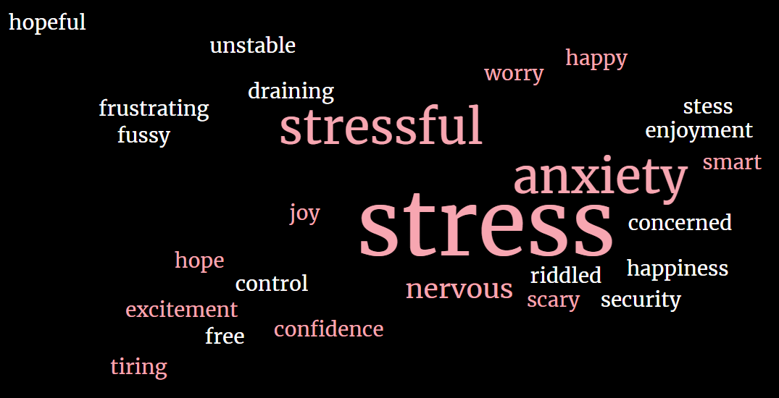

From PIMFA’s Under 40’s Leadership Forum 2023
Gen Z associate long-term financial planning with…
In terms of encouraging them to save long-term, good interest rates are the most commonly cited incentive.
4.15% interest
$1bn in 4 days
Existing ecosystem
Notes:
Links to brand love. FS – hard to generate. Apple does this based on functionality, but has very loyal fanbase. Apple already have the engagement so new products are easier to market.
Brand loyalty

Slide 7
Many are exploring risky ways to stay afloat…
Among Gen Z…
Payday Loan usage
12 month rolling data
10%
Jan 2022
8.2%
July 2022
Have plans to take one out
24%
Jan’21
Now
Have considered it
11-26
27-42

Slide 8
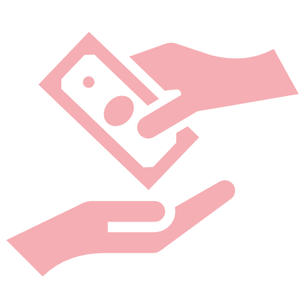





…and it seems they don’t know where to find help
Gen Z reasons for taking / considering payday loans
Consolidate debt
Financial management & education
28%
To avoid my overdraft
Don’t understand risks
28%
22%
26%
Didn’t know where else to turn
Lack of FS positioning
To cover an emergency expense
Unavoidable, but unsustainable
26%
26%
22%
22%
Didn’t want to ask friends & family
Lack of FS positioning
To fund a large purchase
Not just hedonism
26%
19%
Notes:
Re-emphasise: access and visibility, where could/should they go instead? Be top-of-mind

Slide 9
So where DO they turn?
Which of the following would you look to for support and advice to help manage your finances?
Bank
26%
Social media
Family
Friends
20%
Online forums
45%
33%
17%
Most look to their immediate networks…
…but social media advice looks poised to overtake FS firms as the main source of external support
Notes:
Not necessarily an opposition.
Channels engaged with – not mean they TRUST influencers, but brands must be active and visible on platforms to cut through noise

Slide 10




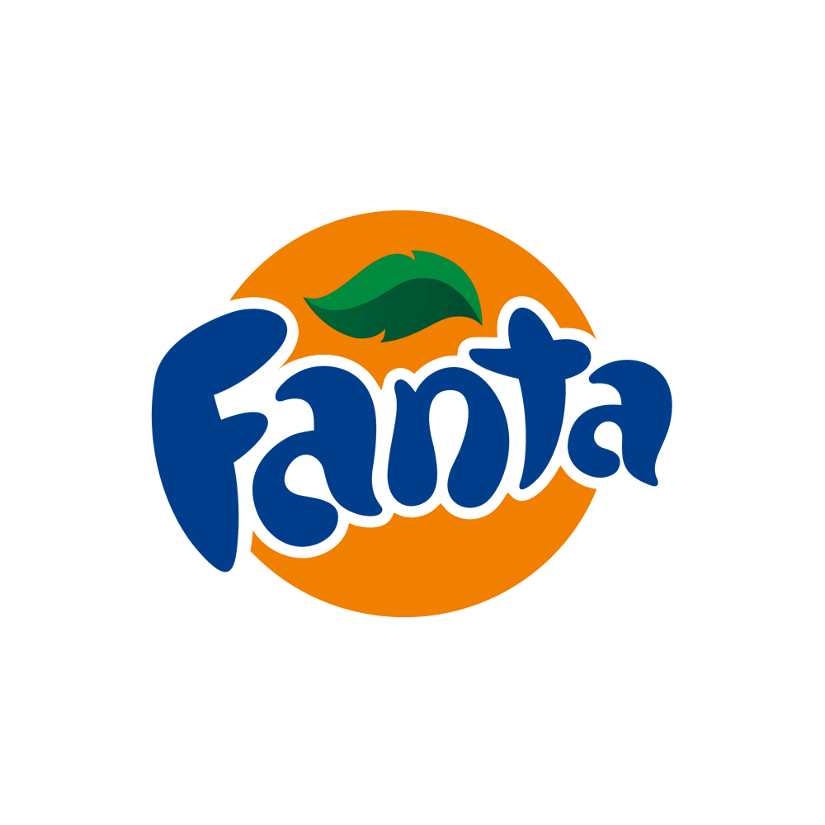





Media consumption is a key part of Gen Z life
Savanta’s Most Loved Brands 2022 – Gen Z
1
6
2
7
Brands should look to target this audience on their
most-loved platforms
Pick creators whose values align with those of your brand and target audience – Don’t be a Bud Light!
3
8
4
9
5
10
Savanta: Most Loved Brands 2022

Slide 11
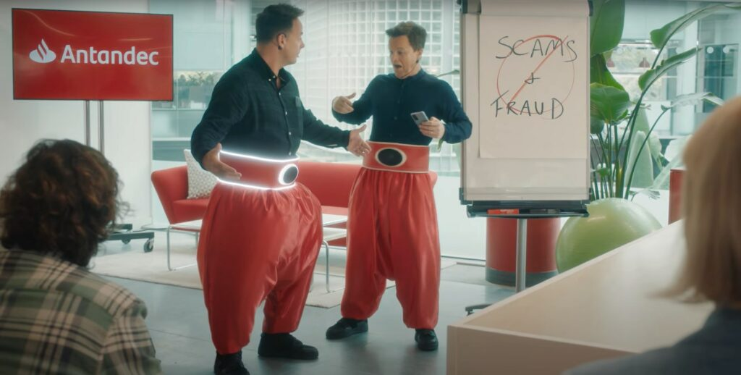
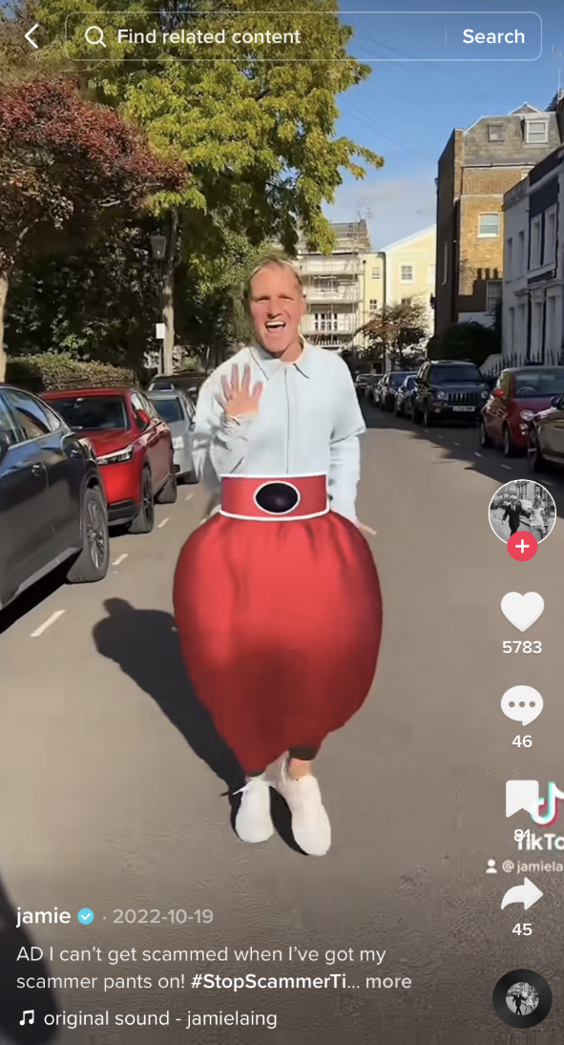
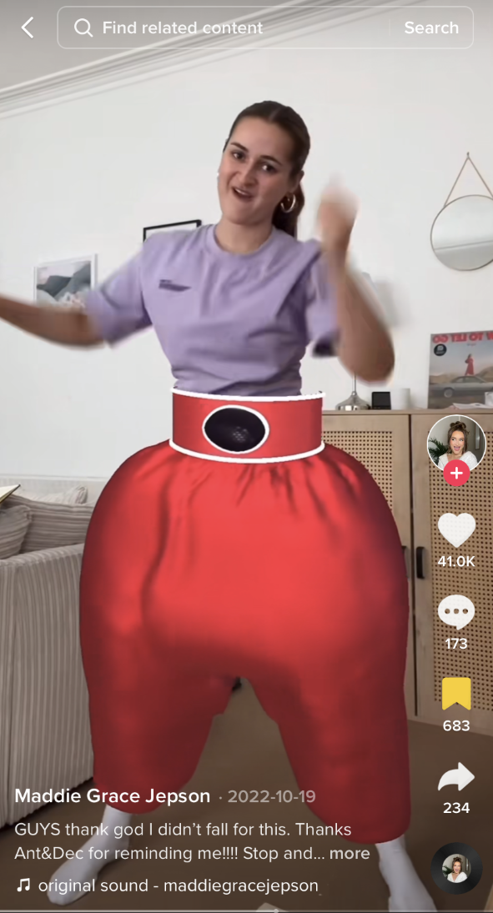
Some UK brands are already using TikTok to great effect
24.4m
Impressions
80%
#StopScammerTime
Aged under 35
5 TikTok Creators
‘Scammer Pants’ filter
Fraud & scam prevention awareness
+7.2%
+2.7%
3.2bn views from user-generated content
Ad recall
(41% relative)
Sentiment
(8.3% relative)

Slide 12
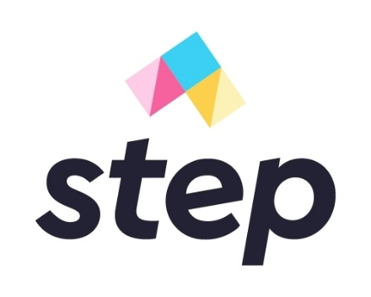
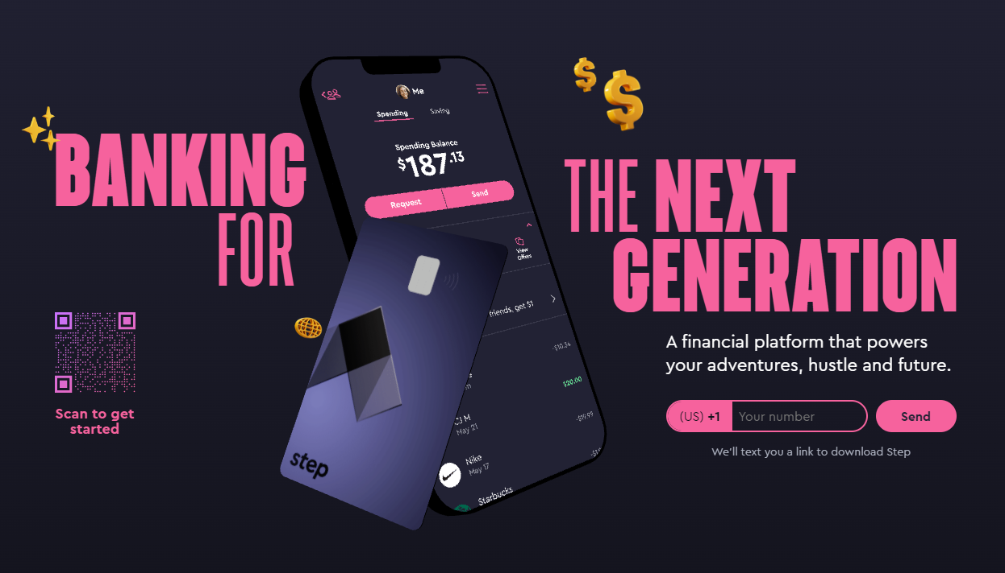
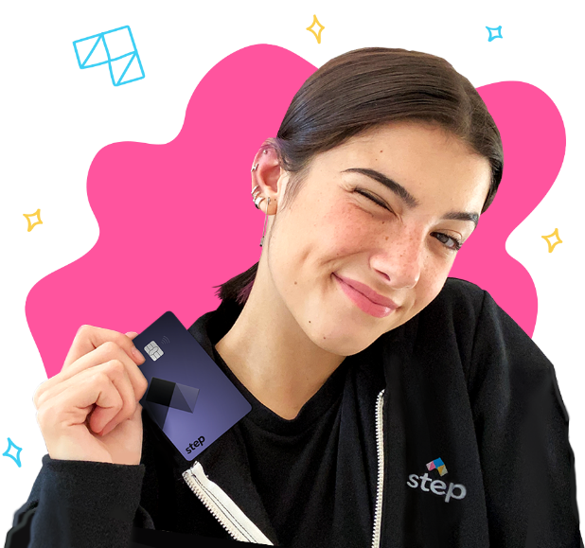
And US challenger brands have been quick to “capitalize”
“Step is a mobile banking app built for teens and young adults who are just starting their financial journey. Our mission is to improve the financial future of the next generation.”
Helps build credit
13+ target audience
Social media marketing
Using popular creators
10’s of millions of views
Website aimed at parents
Notes:
GoHenry

Slide 13
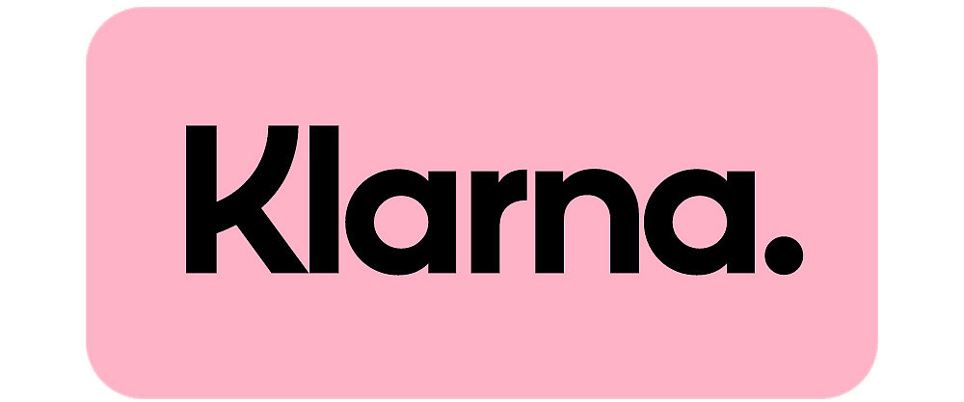
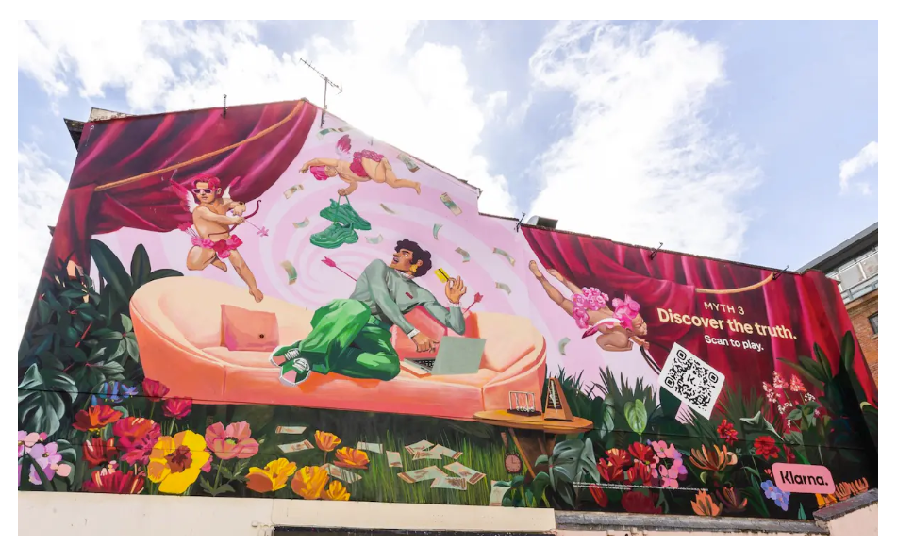
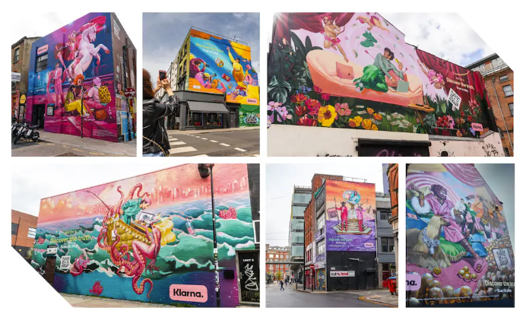
New twists on traditional marketing can also be effective
Discover the truth:
Objective:
Garner trust and change perceptions.
“Set the record straight”
Partner:
Ignasi Monreal
(Artist & social media personality)
Method:
High-footfall mythical ‘canvases’ and QR link to challenges (with prize)
+10%
+52%
+7.3%
Trust
Sentiment
Users
May - July 2021, no other media campaigns
Notes:
Mythical artwork to bust myths about the brand – leveraging bad publicity and spinning into a positive
“A traditional media approach is not sufficient to change behaviour, so instead we’re inviting consumers to debunk in real-time via our interactive experience and discover the truth for themselves,”
Challenge winners win a weekend stay at Claridges and a £10,000 donation to Beauty Banks, the hygiene poverty charity, in the winner’s name.

Slide 14
Do you agree that Financial Services providers are only interested in making a profit?
And Gen Z does trust FS brands more than previous generations
73%
70%
63%
Firms like yours have a genuine opportunity to capitalise on this more positive sentiment
The key is communicating in the right way, through the right channels, and with the right messages
Brands like Step will help to reinforce this, and you could too
60%
57%
49%
50%
40%
30%
Trust:
69%
42%
29%
Financial
providers
Traditional
news reporter
Print
media
Gen Z
Millennial
Gen X
Baby Boomer
11-26
27-42
43-58
59-77
Notes:
Doom and gloom at the beginning, but there is real opportunity
Trust is not a barrier, you just need to get that engagement!
Brand loyalty.

Slide 15
So, in summary…
Gen Z are growing up in a complicated time, and to connect with them we must see the world through their eyes
They are deeply concerned about their financial health and increasingly resorting to dangerous ways to stay afloat, despite trusting FS providers more than past generations
Social media is becoming a go-to platform for information and guidance on financial management, and brands must make themselves visible
The financial brands already taking advantage of these outlets are seeing fantastic engagement among this younger audience

Slide 16




What does this mean for you?
Gen Z present a major opportunity for brands to engage a trusting audience
Build perceptions that you are the
go-to place for support
Digital FS marketing has been proven to boost engagement and usage
Established institutions must act to avoid major losses to challengers

Slide 17
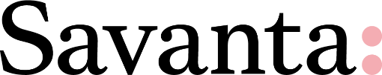
Next up is our Gen Z panel …
Contact Us
Matt Thomas
matt.thomas@savanta.com
Sarah
Lydia Daniel
lydia.daniel@savanta.com
Vrajti
Roger
60 Great Portland Street
London
W1W 7RT
Sarah
Isabella

Slide 18
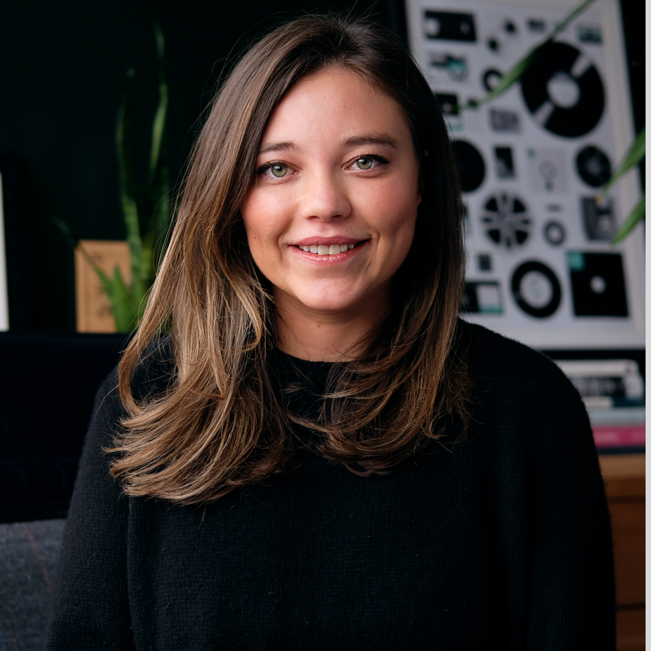
The Psychology of Being a Good Leader
Ziba Goddard
Chief Consulting Officer
Cowry Consulting

Slide 19
The Psychology of Leadership
Notes:
Thanks for having me. I’m Ziba, and I’m the Chief Consulting Officer at Cowry and I started the business with 3 others in 2015. My background in experimental and clinical psychology, coupled with a few years in Asset Management, so was well placed to develop a consultancy predominantly dedicated to improving the customer and employee experiences in the financial sector.
So I’m going to be talking today about the psychological foundation of leadership, which is the art of building trust.
I’m going to talk through the science behind trust and the traits and behaviours that trusting leaders have in common.

Slide 20
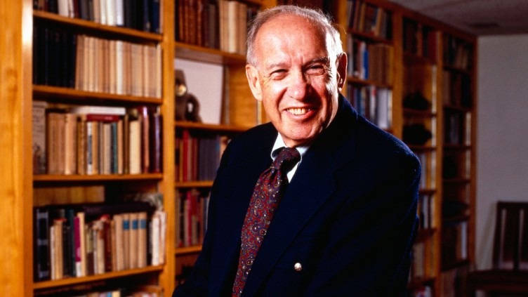
“Leadership is an achievement of trust”
Peter Drucker
Notes:
Peter Drcuker, who’s often described as the ‘founder of modern management’ said it best
He advocated respect for employees and talked about them as assets not liabilities, so the key of leadership is to earn and keep their trust.
Amd whilst Peter Drucker said this a few decades ago, the current research matches his theory.

Slide 21

Business leaders who believe employees highly trust their company
Company perceptions
≠
Employee perceptions
Employees who highly trust companies
https://www.pwc.com/us/en/services/consulting/library/consumer-intelligence-series/trust-new-business-currency.html
Notes:
PwC’s 2022 Consumer Intelligence Series Survey looked at perceptions of trust in business between leaders and their employees to see whether there was a discrepancy between these two.

Slide 22
84%
15% difference
Trust Gap
69%
https://www.pwc.com/us/en/services/consulting/library/consumer-intelligence-series/trust-new-business-currency.html
Notes:
The results showed a jarring gap in trust between business leaders and their and employees with 84% of business leaders saying employee trust is high, compared to 69% of employees.
This has led pWc to conclude that trust in the new business currency.

Slide 23



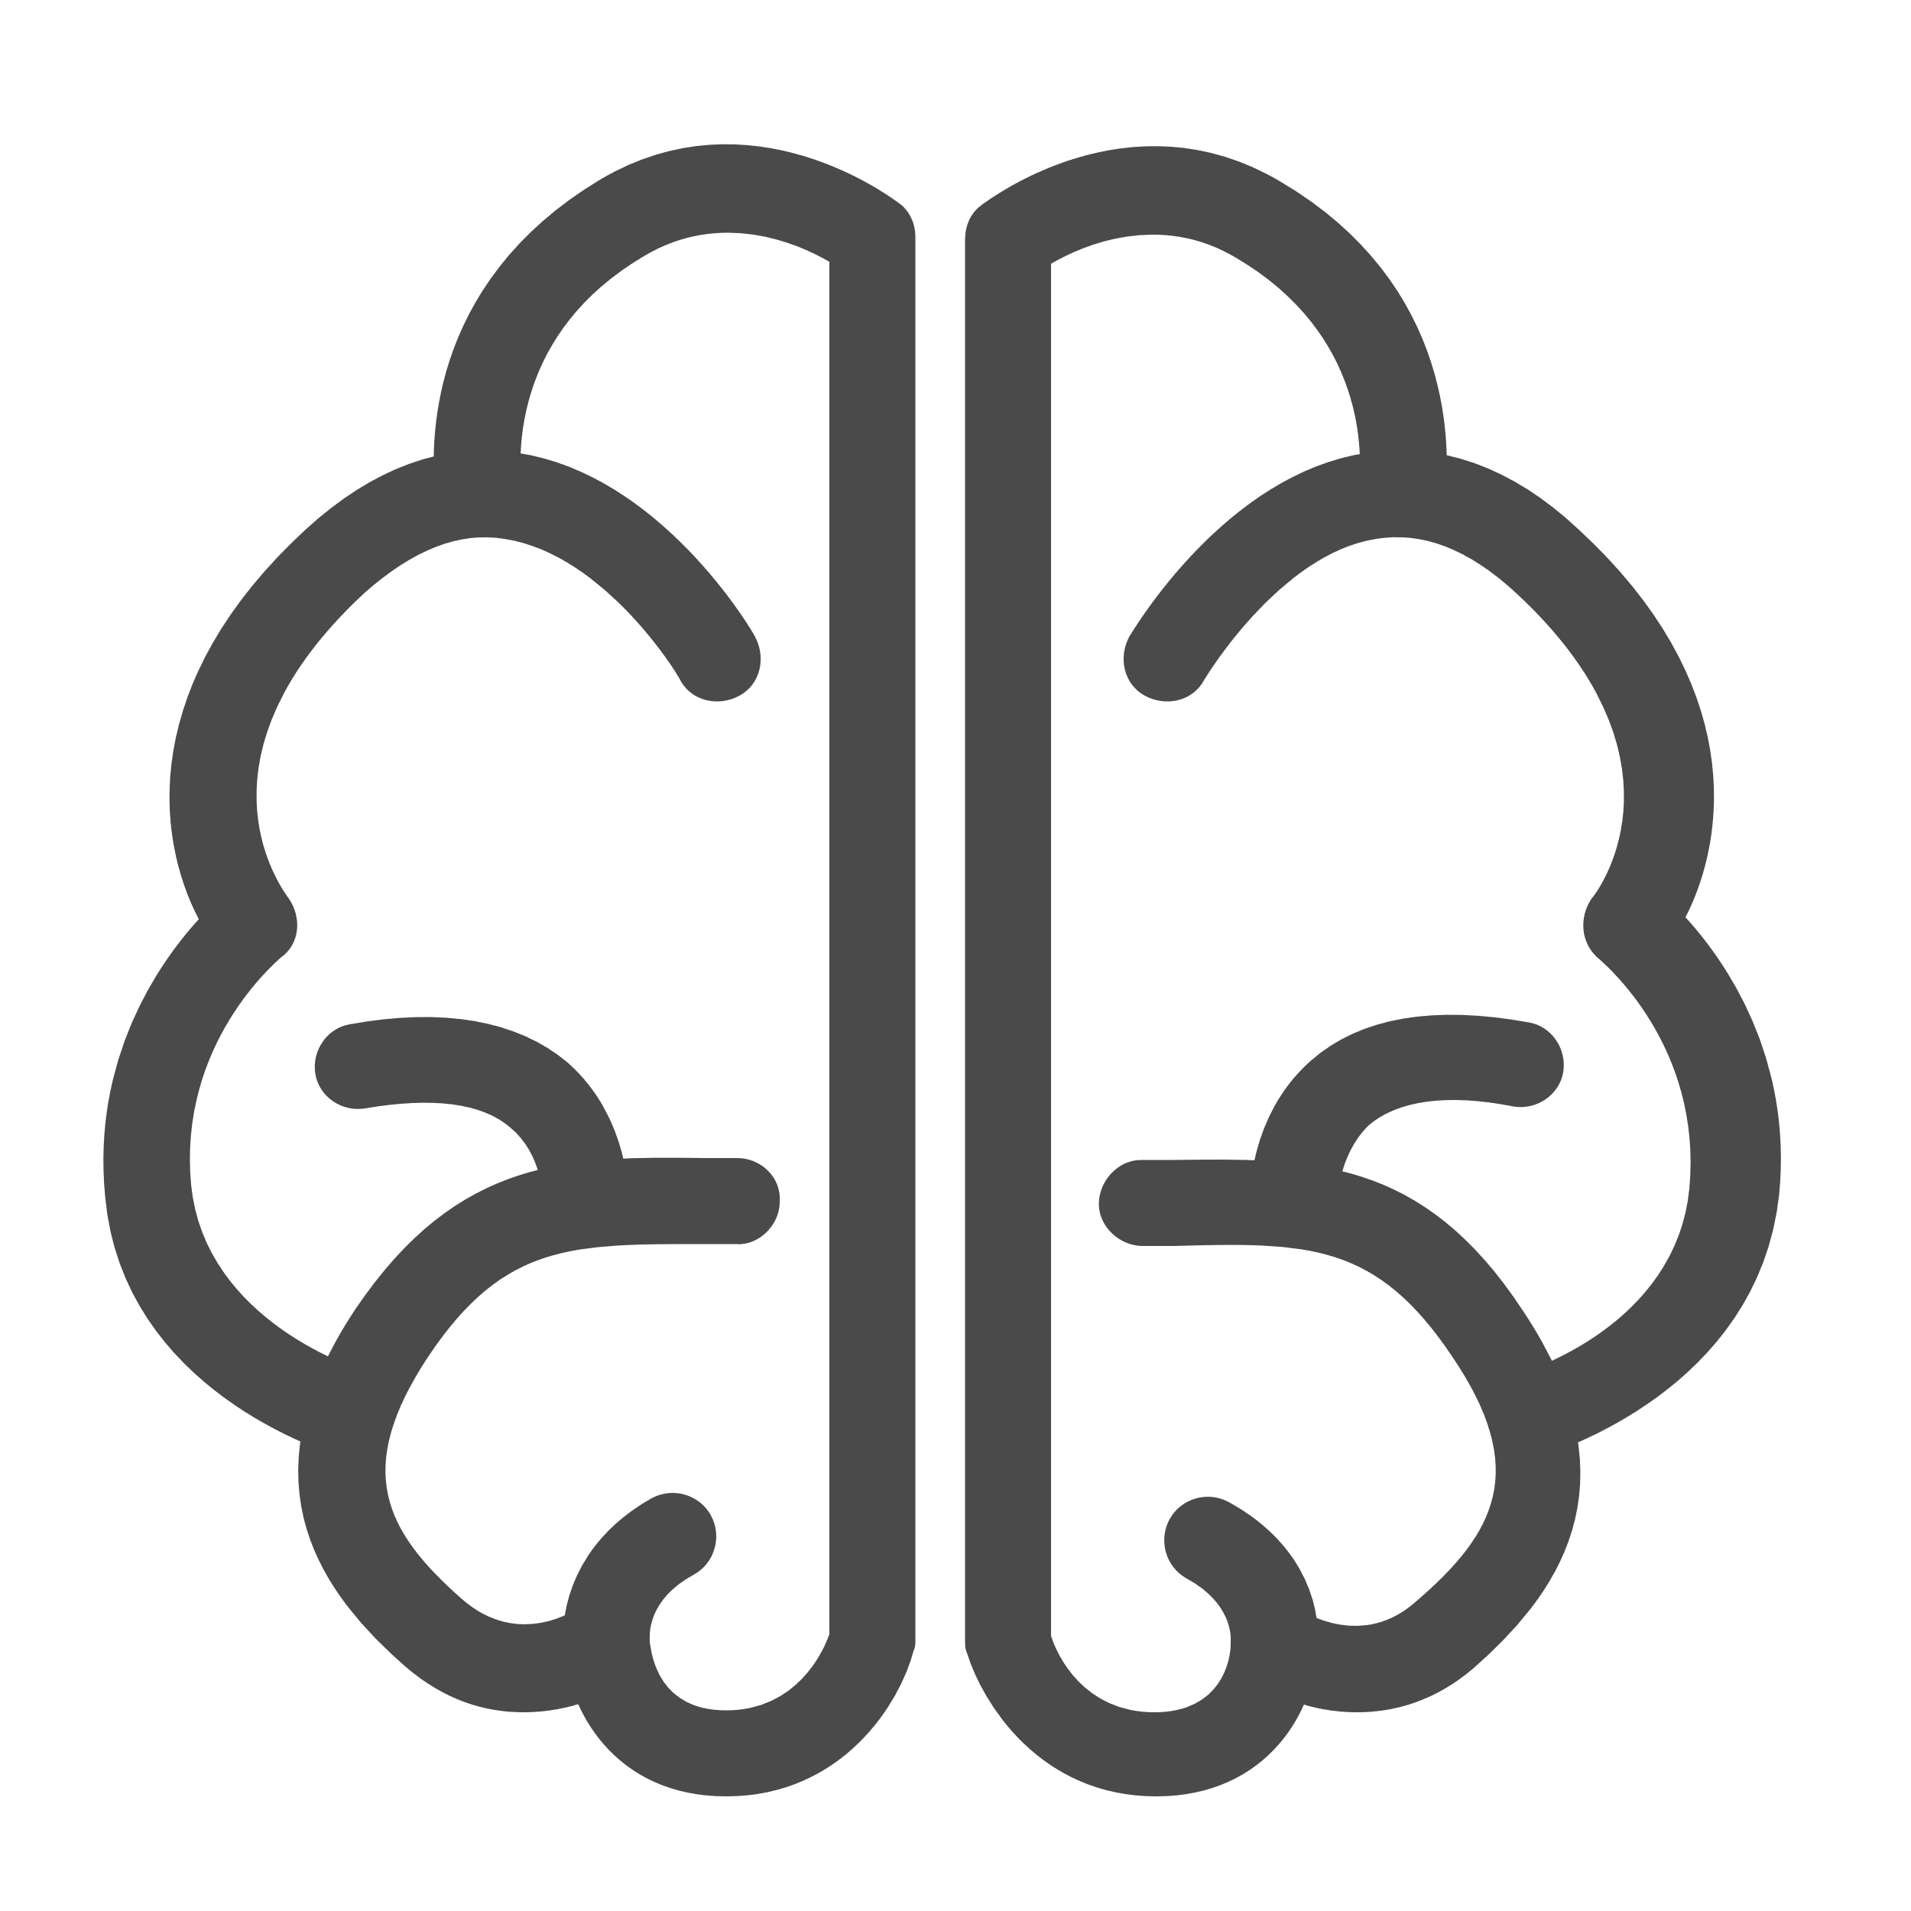
When leaders are trusted…
Rated 8X more as “Exceptional”
2X better at retaining people
Outperform their competitors by over 6%
Best for neurodiverse employees.
S. Valcea, M.R. Hamdani, M.R. Buckley, et al., “Exploring the Developmental Potential of Leader-Follower Interactions: A Constructive-Developmental Approach,” The Leadership Quarterly 22, no. 4 (August 2011): 604-615.
Notes:
And there’s LOTS of opportunity, if we get it right!
Research has shown that leaders who are trusted:
Employees who trust their leaders are 8X more likely to believe their leaders are exceptional in their role.
Team members who trust their leaders are more engaged, and they are twice as likely to stay the company.
Trusted businesses also outperformed their lower-ranked peers by over 6% in the market.
A trusting relationship is required for performance feedback to be meaningful and effective for neurodiverse employees.

Slide 24
The characteristics of trust
Notes:
So let‘s talk about the psychological characteristics that underpin trust

Slide 25
The characteristics of trust
01
02
03
Grows over time
Is Rational AND Emotional
Is a two-way relationship
Notes:
There are 3 key characteristics and I’ll take these each in turn

Slide 26
The characteristics of trust
01
02
03
Grows over time
Is Rational AND Emotional
Is a two-way relationship
Notes:
The first is that trust has to be earned over time.
As humans we are quick to form initial impressions of people, such as whether we think someone is credible or whether we like someone or not. We then look for evidence that supports our initial impression – we call this confirmation bias.
However, this doesn’t happen with trust!! And the language we use shows us this.

Slide 27
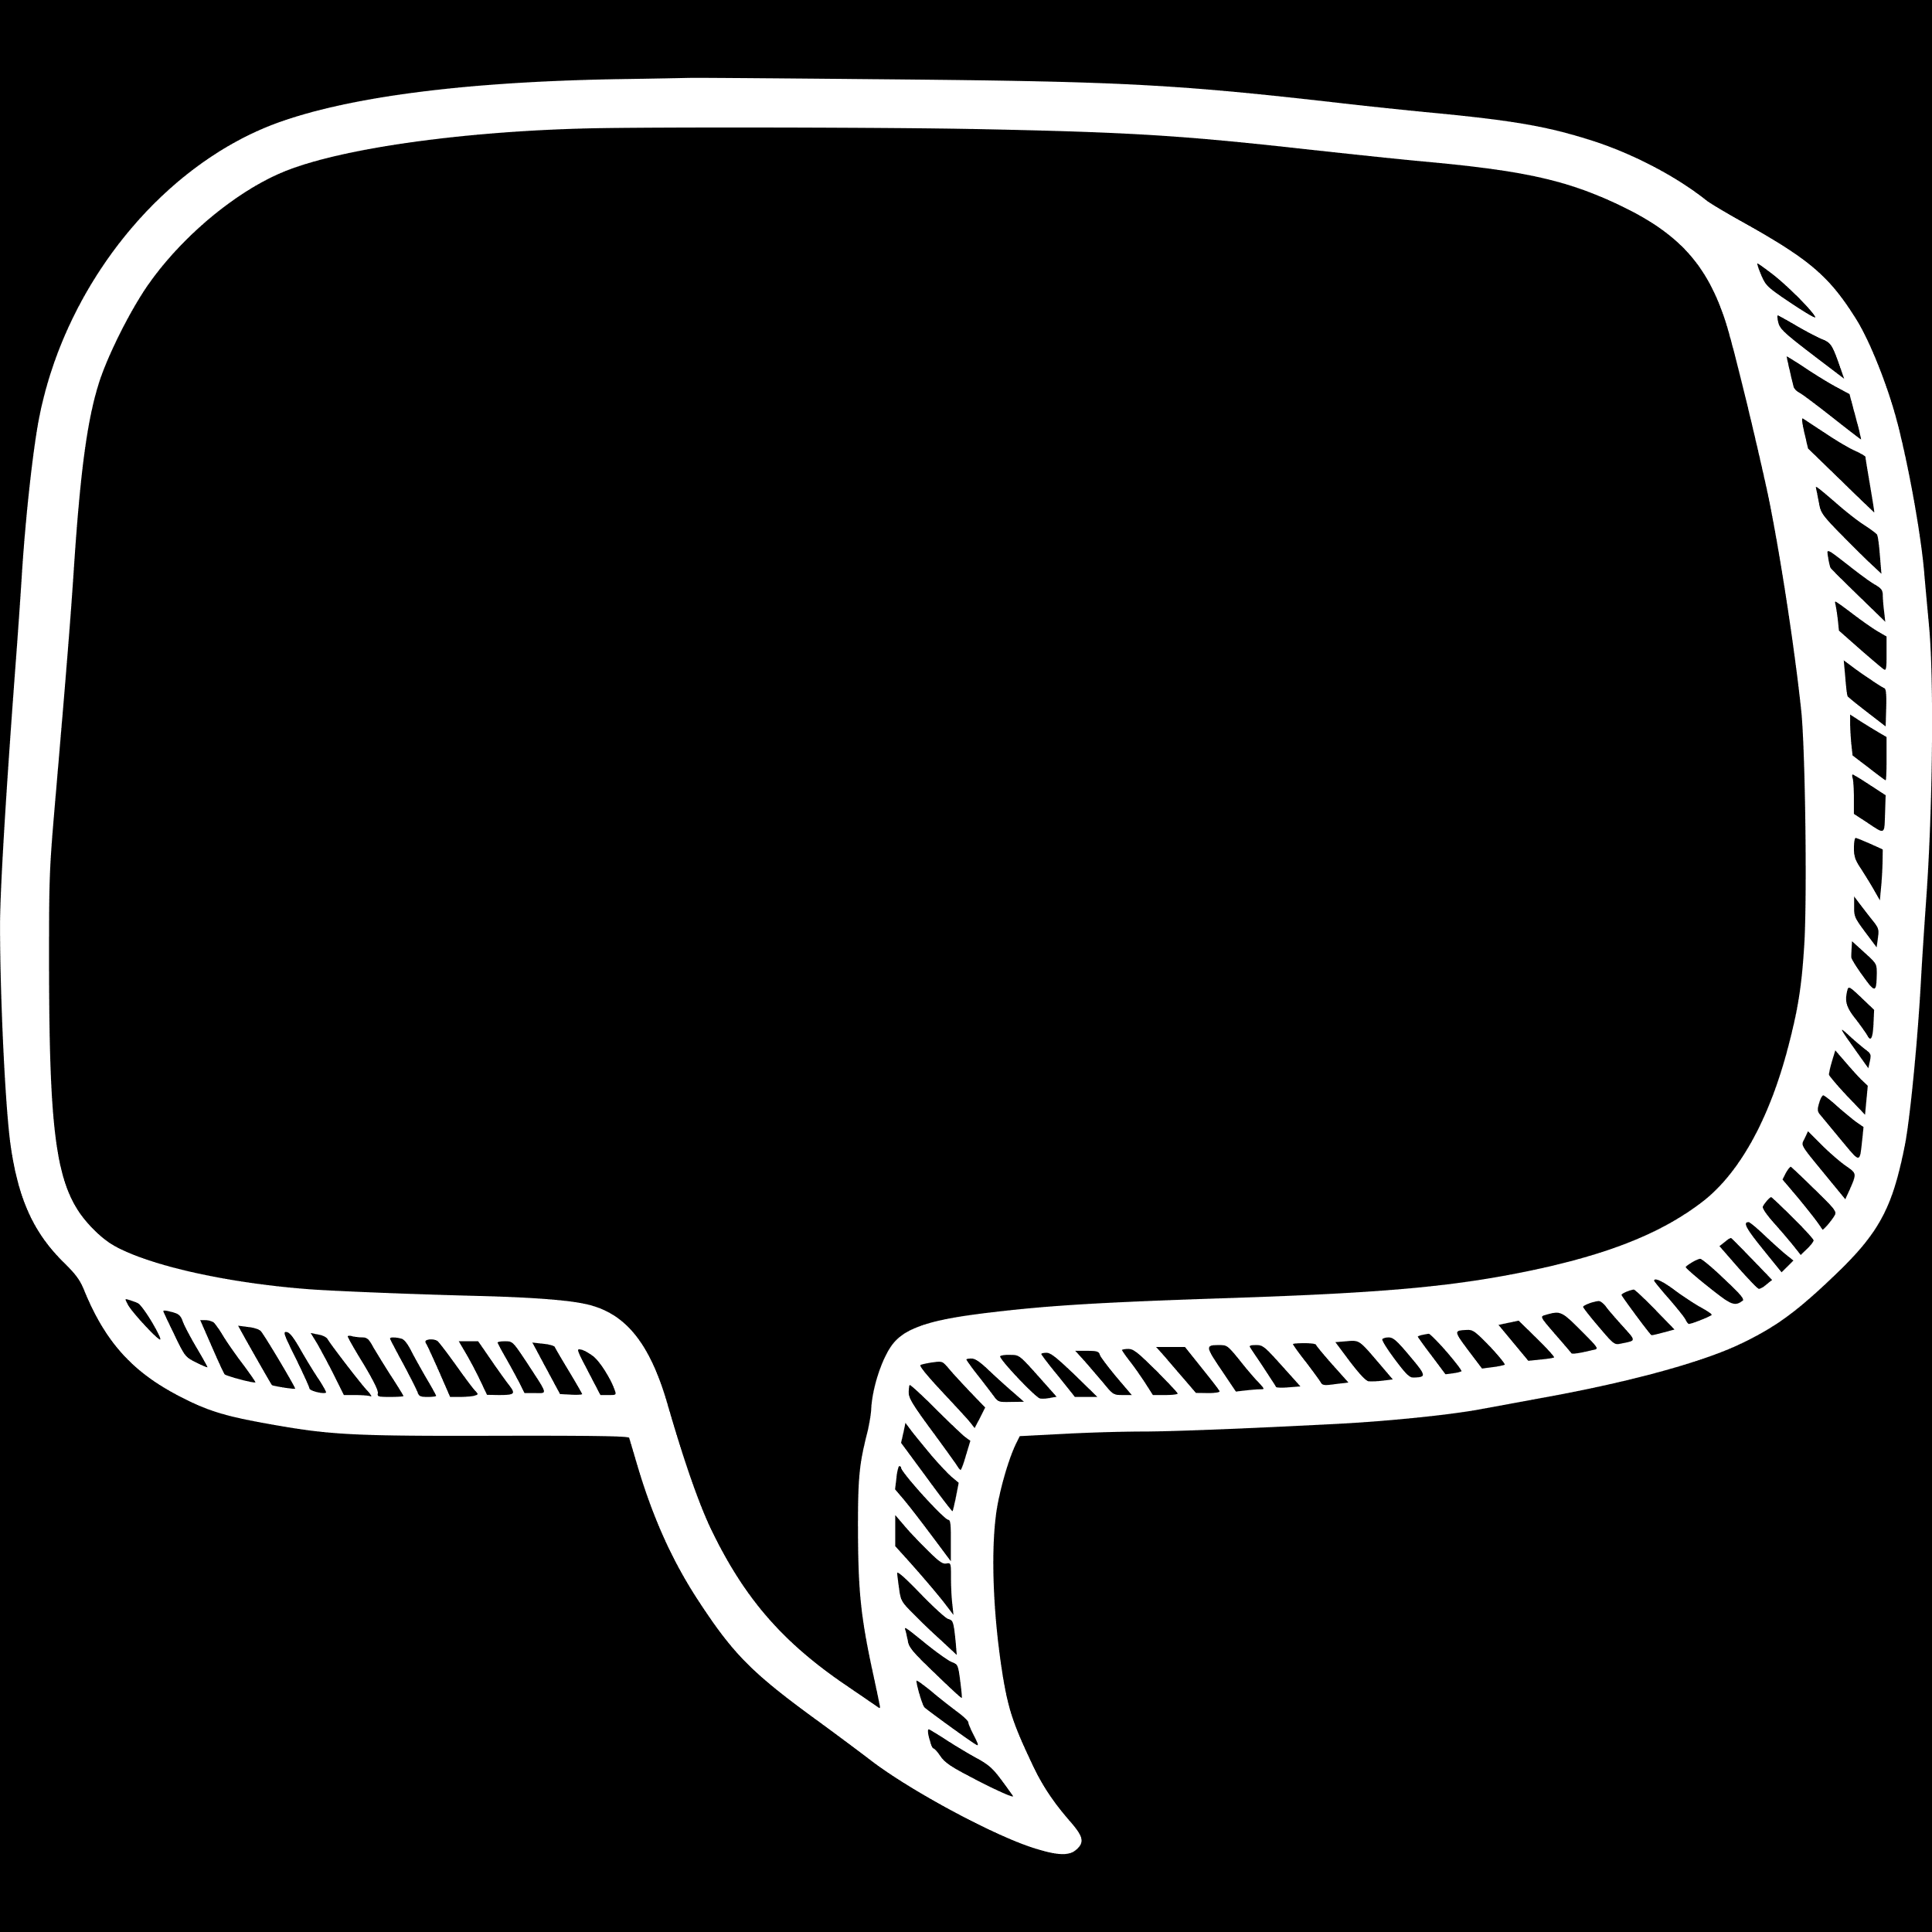
“She seems untrustworthy”
“I trust him”
Notes:
We’d never say in the fist few minutes io meeting someone “I trust him”. We might, however, say “I don’t trust him” or “She/ He seems trustrworthy”.
So building trust has to be given the time it needs to properly develop.

Slide 28
The characteristics of trust
01
02
03
Grows over time
Is Rational AND Emotional
Is a two-way relationship
Notes:
Contrary to what we’d believe that trust in an emotional connection, it actually has a rational component to it.

Slide 29
Notes:
As lots of you will know, Daniel Kahneman who wrote the book “Thinking Fast & Slow”, won his nobel prize for the understanding that we have two processing systems within our brain.
He called them System 1 & System 2 because he’s not a marketeer (unlike you guys). System 1 is in the cerebellum and makes judgements fast, so will immediately attuned in to cues of trustr, such as whether someone maintains eye contact, or whether they listen to us properly before responding.
Spock on the other hand is our prefrontal cortex and developed much more recently, and is in the only part of our brain that differentiates us from primates (monkeys). This part of our brain takes longer, and so will take it’s time and so will be looking to understand whether we follow through on our promises, and that our stories line up.

Slide 30
Notes:
So the difference between these to systems is …
And although 90 - 95 % of our decisions originate in our Homer brain, our spock brain has the power to override whether or not Homer has decided someone’s trustworthy.

Slide 31
The characteristics of trust
01
02
03
Grows over time
Is Rational AND Emotional
Is a two-way relationship
Notes:
And the final characteristic is that trust is a two way relationship.
We can love, hate, or respect a person without the person doing the same back. I have many painful experiences of unrequited love – but that’s for another conference!
But the same can’t be said of trust. You can’t create a trusting relationship on your own!
Trust can’t exist in a vacuum

Slide 32

Reciprocity
Notes:
And this is because of the principle of reciprocity, which explains how we’ve evolved to form social networks in the form of reciprocity.
In other words, If I give you something you want to return the favour, often with a greater benfiotin kind.
Waiters know this. Tips → 23%.
And that’s how leaders build trust with employees.

Slide 33
Trust takes time
Leader
Employee
Leader
Employee
Notes:
At the start of a relationship, there’s some distance between leaders and their employees.
But over time the leader shares some thing with the employee, either a moment of revelation, perhaps exposing some vulnerability. And this creates the opportunity for the employee to reciprocate and so they get closer.
And then at another point, perhaps in the pub, the leader may share a joke which allows the employee to reciprocate in a similar tone, and so the dance goes on. Until we reach the sweet spot whereby trust has been built and employees are will to follow their leaders and share their vision.

Slide 34
How to build trust
Notes:
So how do we build?
David Maister is the expert on Trust and developed the famous Trust Equation which some of you will be famiailr with. And the reason I love this equation is that it’s firmly rooted in Behavioural Science.

Slide 35


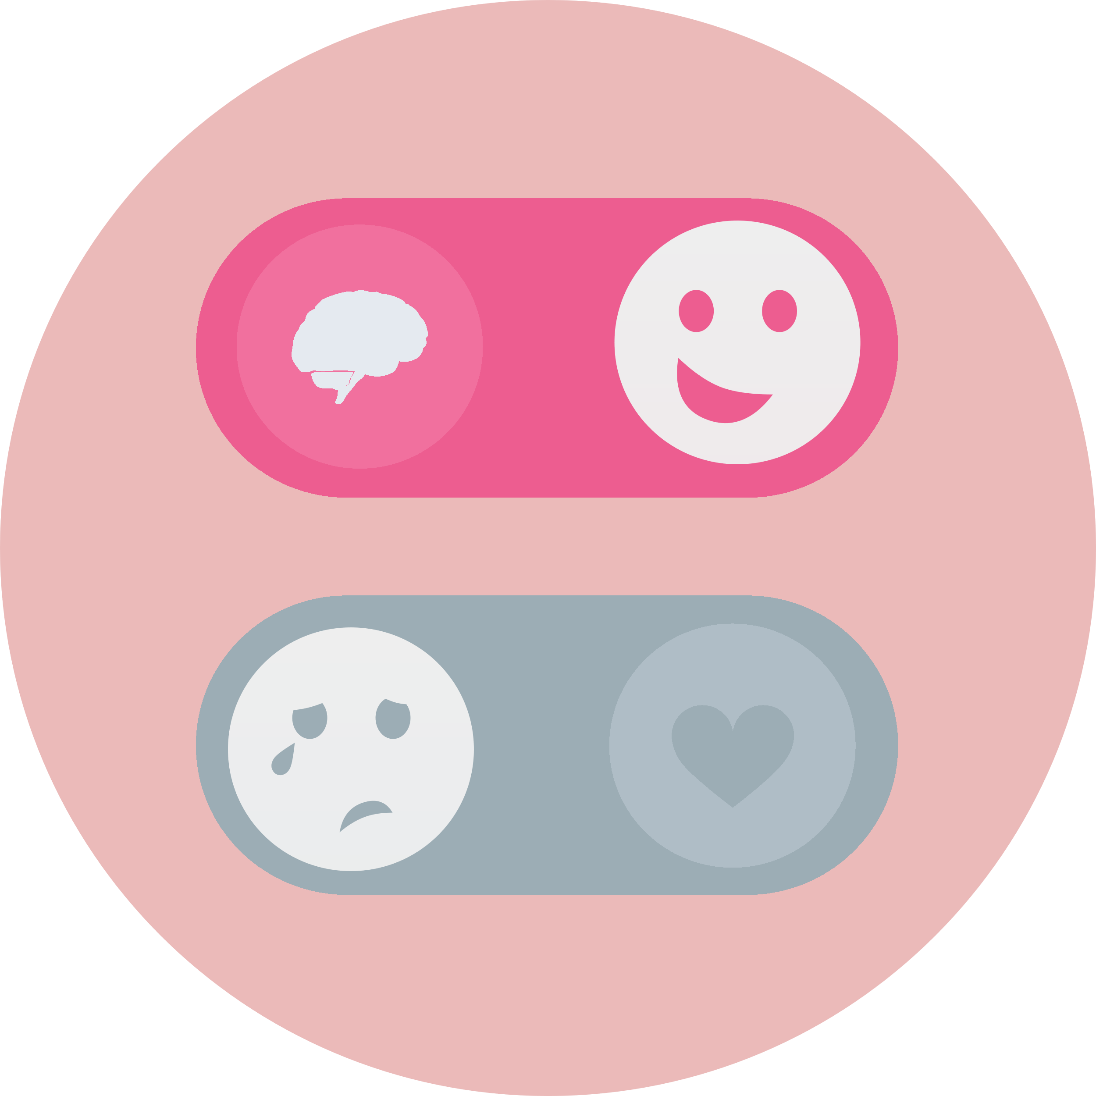

What makes someone trustworthy?
Credibility
Reliability
Intimacy
Self-orientation
Maister, D. H., Galford, R., & Green, C. (2001). The trusted advisor. Simon & Schuster.
Notes:
Credibility is about showcasing experience and expertise - And it’ about the WORDS we use.
And this because we have an Authority Bias → We trust people who we deem to be authorities. Fpositions such as doctors or celebrities, therefore we place more importance on their opinions and contributions. We are often biased by subtle, sub-conscious priming cues in the nature of the authority conveying the information. We are more likely to follow guidance from doctors wearing stethoscopes than without and buy from property agents with certificates behind their desks in their offices.
And this component of trust is about:
What we say
Can be most easily achieved
Refers to how capable we think someone is
Reliability is about keeping promises so it’s our ACTIONS
And this is because we an have an aversion to ambiguity, and a fear of the unknown! Research ahs shown that people prefer to gamble rather than choose a life insurance policy because we have a preference for risks that are associated with known probabilities than uncertainties where probabilities are unknown. When our expectations are managed, it allows us to plan more effectively. We tend not to make decisions where the choices and commitments are ambiguous.
And this component of trust is about:
What we do
A track record of consistency
Creating transparent environments to boost reliability
Intimacy is all about connecting so it’s about our EMOTIONS
And this is because of Affect: Research has shown that our emotional associations can powerfully shape our actions. The types of decisions we make are dependent upon our state of emotional arousal. Generating a positive mood is a powerful tool to encourage positive behavioural outcomes.
And this component of trust is about:
Making others feel emotionally secure and holding a space for their vulnerability.
A workplace that focuses on building psychological safety will help connect individuals and build intimacy.
Self orientation is about being ‘other focused’ rather than self-focused’ so it’s all about our MOTIVES
And this is particularly hard for us because of our innate ego bias which explains that we tend to overestimate our own importance. In particular, we overestimate our positive qualities and abilities, and underestimate our negative qualities relative to others.
And this component of trust is about:
Putting others interests ahead of your own interests ahead of others
Caring for and paying attention to others displays a low self-orientation
The most important component of trust
Putting your own interests ahead of others
Caring for and paying attention to others displays a low self-orientation
The most important component of trust

Slide 36
Trustworthy behaviours

Slide 37
Credibility
Authority Bias
Use examples
Don’t lie
Love your work
Showcase your expertise through your extensive experience using concrete and tangible examples. Spock is looking for ‘believability’.
Pretending to know, exaggerating or lying are the quickest ways to undermine credibility. Homer is looking for ‘honesty’.
Showing your passion will boost perceptions of your credibility. Homer is looking for ‘passion’.

Slide 38

Reliability
Ambiguity Aversion
Tell them & tell them again
Be on time
Set clear goals
Share relevant plans as soon as possible and give status updates regularly
As it’s the first impression, it sets the tone
From single meetings to annual ambitions, setting goals and ensuring they are met will boost reliability

Slide 39
Intimacy
Affect
Practice phrasing
Go first
Recognise them
Test out different phrasing options for delivering more difficult or sensitive messages
Increased intimacy starts with one person taking a personal risk and sharing something
Publicly or privately, acknowledging a job well done will improve your relationship

Slide 40
Self-orientation
Ego bias
Empowered culture
Talk less
Show you care
Research shows that involving employees at the decision stage increases wellbeing
Relating stories to ourselves, finishing other people’s sentences or needing to have the last word all signal self-orientation
Remembering and replaying their thoughts and feelings demonstrate active listening and a desire to help

Slide 41
The trust equation
Credibility
+
Reliability
+
Intimacy
Self-orientation
/
Maister, D. H., Galford, R., & Green, C. (2001). The trusted advisor. Simon & Schuster.
Notes:
Trust has multiple dimensions - I may trust your expertise (credibility) but profoundly distrust your motives (self-orientation)
So this is how the trust score works….
I’ve recently run a leadership course for a big Asset Manager, where employees rated their leaders, and let’s just they were rather surprised by their trust scores!
If anyone’s brave enough to as their teams to do the same, please come and hunt me out and I’ll share what we learn.

Slide 42
zibagoddard@cowryconsulting.com
Notes:
Thank you very much and would love to take any questions you may have.

Slide 43

Coffee Break and Mini Break-Out Task

Slide 44
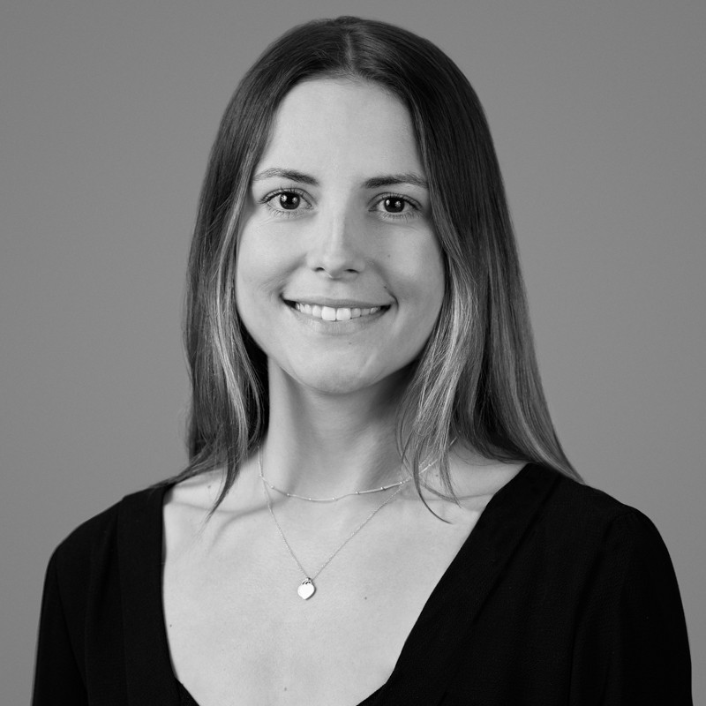
Meet the Young Marketer of the Year 2022
Laura Hammond
Marketing Manager
Waverton

