Slide 1
FS Forum
1st December 2022
Consumer Duty and the Customer Understanding Outcome

Slide 2
1. Consumer Duty –
Customer Understanding Outcome
Consumer Duty requires firms to reassess their communication priorities, culture and approach – it requires a fundamental shift for how communications are planned, designed, processed and measured.

Slide 3
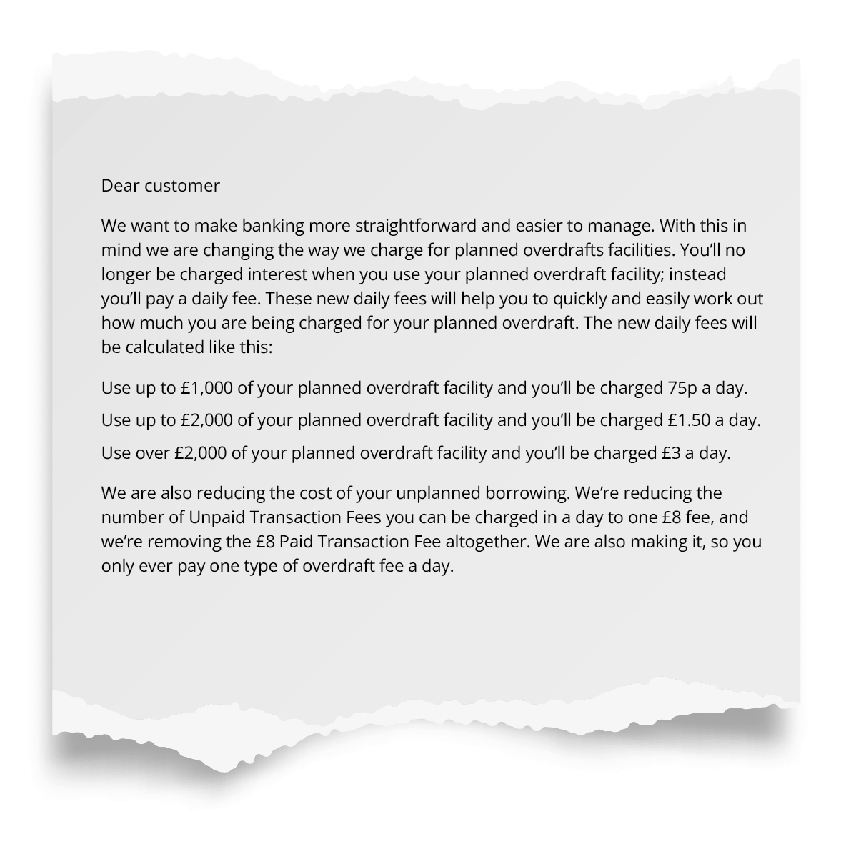
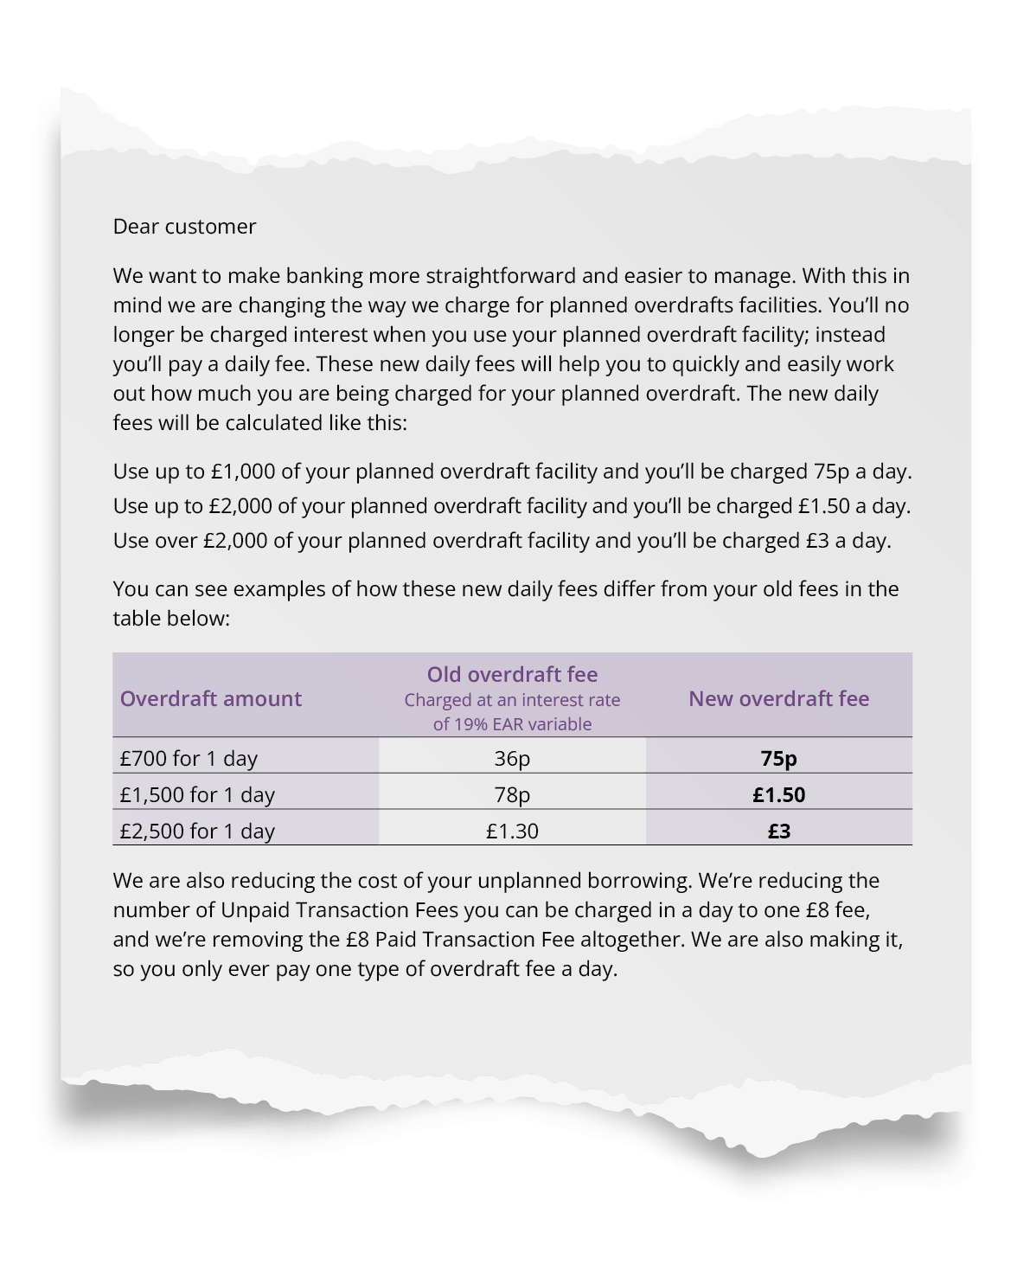
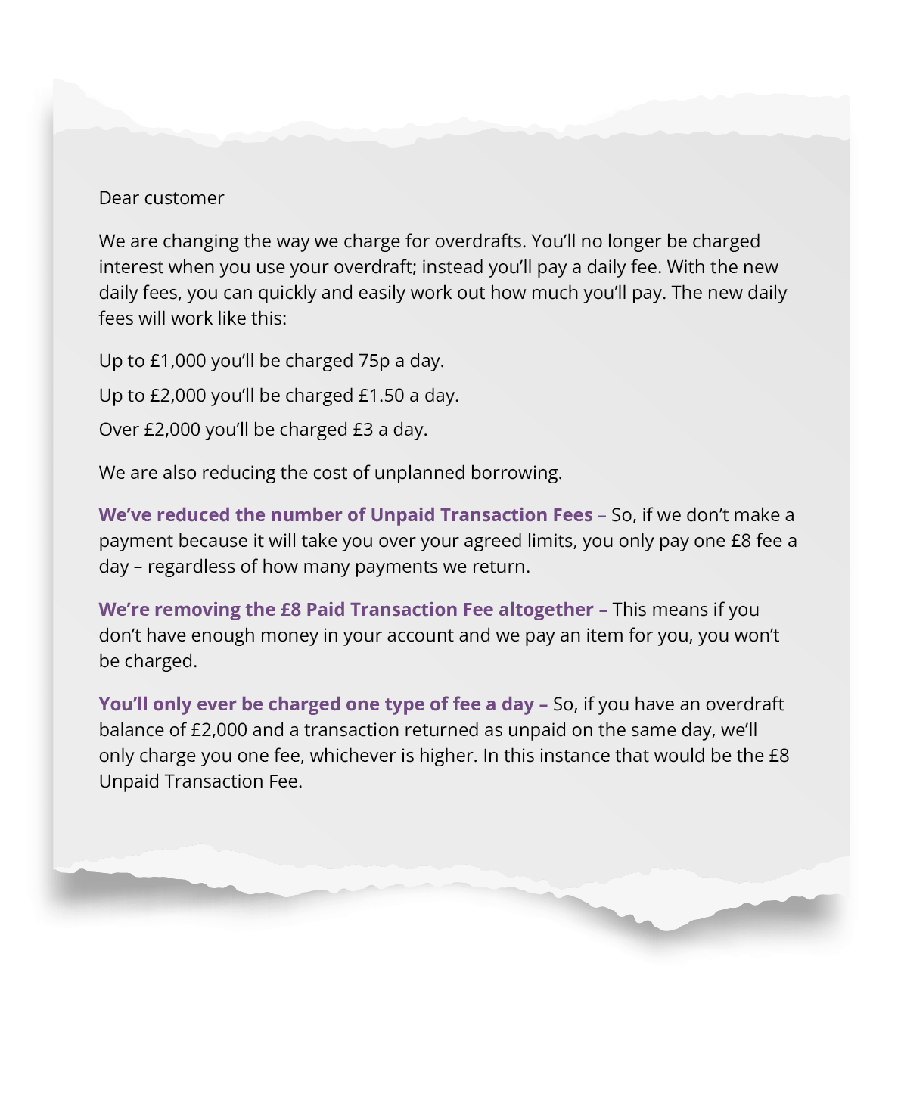
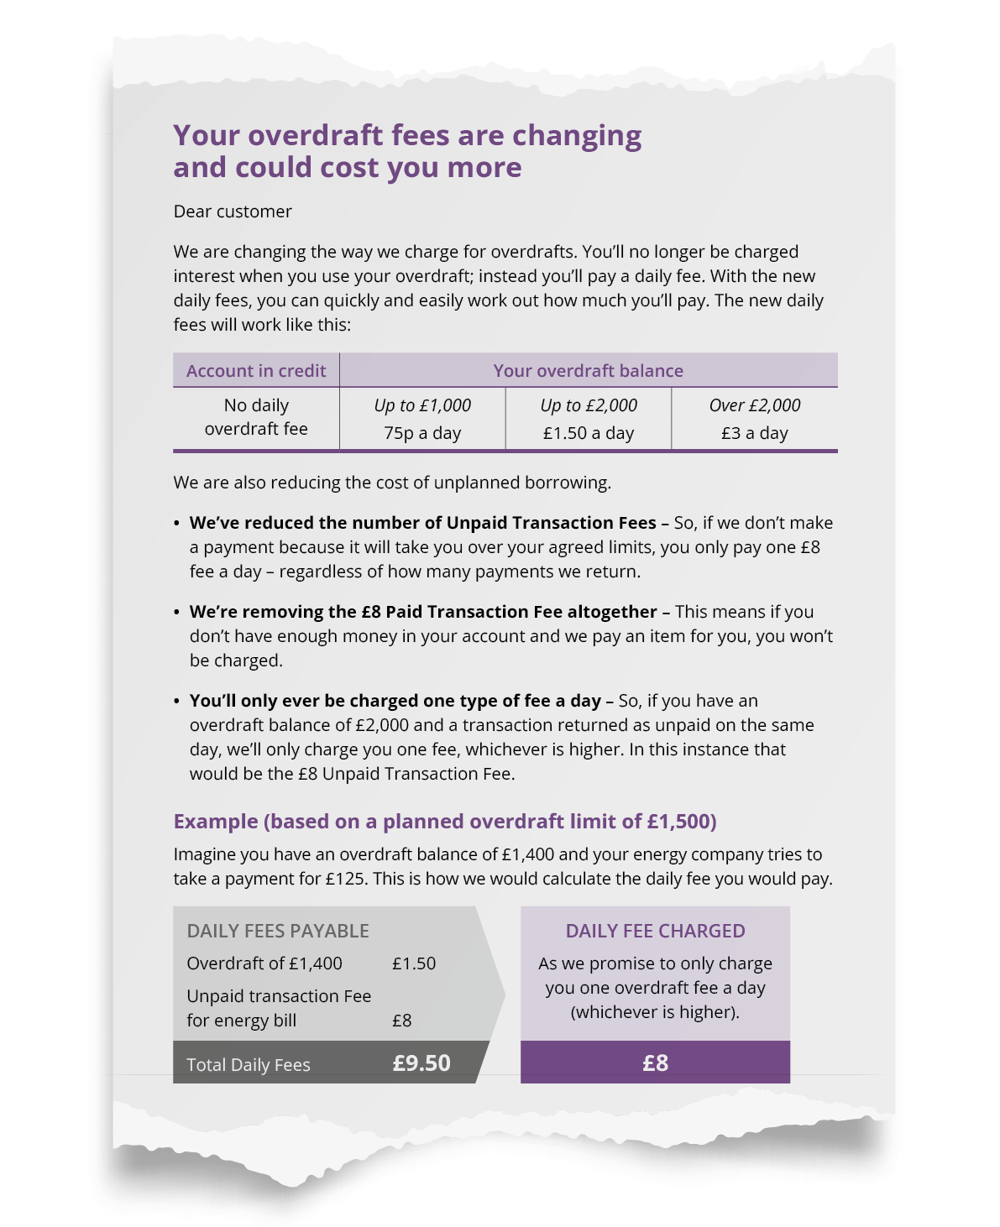
1 CONSUMER DUTY - SIGNAL RESEARCH ON CUSTOMER UNDERSTANDING
People don't understand much about financial matters
Our proprietary research highlights the level of understanding of consumers. The best performing example had a 48% correct answer rate. The rest ranged from 13-28%.
13%
48%
18%
21%
Good design principles can make a big difference to customer understanding, but that alone doesn't go far enough.
96% said that reminders are hugely helpful, with 74% of those preferring email
Total sample: 1,018 split into 8 equal groups and versions

Slide 4
1 CONSUMER DUTY & COMMUNICATIONS MANAGEMENT
Customer Understanding outcome taxonomy
This outcome taxonomy creates a detailed view of what is required to align to FCA requirements.
Level 1
Level 2
Level 3
Provision of information that equips consumers to make effective, timely and properly informed decisions about financial products & services
Avoiding Harm: Acting to avoid causing foreseeable harm at all stages of the customer journey whether that be for segments of customers or interactions with individual customers
1.
Communicating terms clearly, highlighting key risks for consumers with prominent disclosure, and explaining risks in a way that are easy to understand
2.
Consideration to the consumers' information needs throughout the lifecycle of the product
3.
Ensuring the necessary calls to action are in place to avoid something that would negatively impact the consumer
4.
Testing communications where appropriate to support consumer understanding so that they can make effective decisions and act in their interests
Supporting Consumers in pursuing their financial objectives: Increasing the likelihood of customers to make decisions that are in their interest by delivering clear communications. And where appropriate provide additional signposting & guidance
5.
Consider the characteristics of the customers that the communications are aimed at and tailoring their communications accordingly, so they are likely to be understood
6.
Help customers navigate the information provided and make it easy for them to identify the key information and their available options.
7.
Have systems and processes in place to test and monitor impact of communications on consumer understanding and use outputs to continually improve communications.
Source material: Financial Conduct Authority | FG22/5 | July 2022

Slide 5
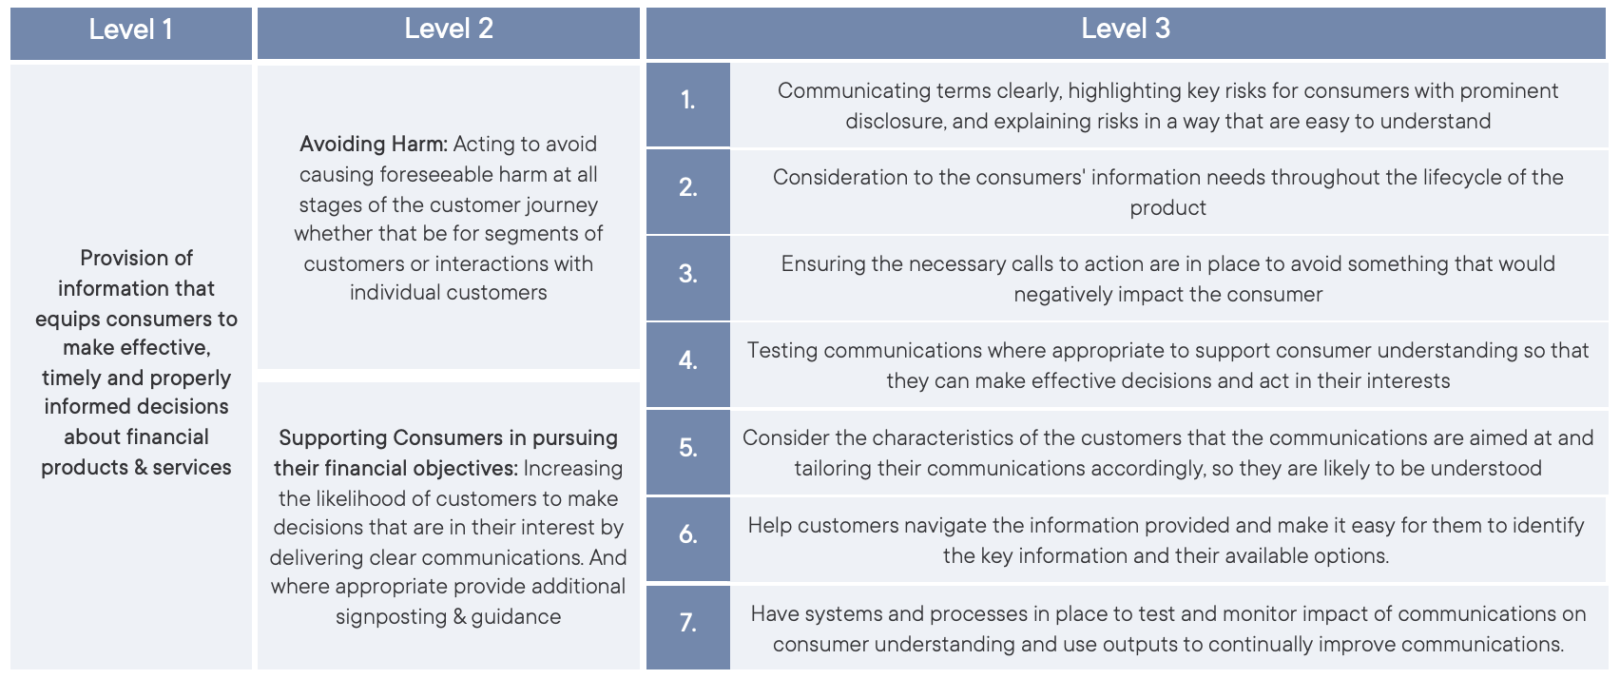
1 CONSUMER DUTY & COMMUNICATIONS MANAGEMENT
Outcome taxonomy provides a more granular & consistent focal point for all key tasks
Governance, Control & Oversight
Research & Insight
Assessments & Audits
Measurement & Reporting
Priority Journeys &
Moments of Truth
Composition
& Deployment of Comms
Development &
Management of Comms

Slide 6
1 CONSUMER DUTY & COMMUNICATIONS MANAGEMENT
Practical tasks to get hold of
Getting into these tasks and applying them into communications will create alignment to all level 3 statements in the Outcome Taxonomy.
A. Preparation
B. Activation
[Planning & Design]
C. Activation
[Management & Governance]
1.
Harms Assessment:
ID journeys that have a high propensity to cause harm or impede a customer's financial objectives
1.
Contact Strategy Development
Contact rules, permissions, preferences and business rules to deliver a framework for better communications management
1.
Measurement & Reporting
MI Framework to demonstrate outcomes are being delivered
2.
Customer Research:
What is and isn't understood today/ ways to explain it better/ how your customers want to be kept informed
2.
Customer Segmentation
Consumer Duty segmentation model around harm not sales
2.
Customer Journey [management]
Training, implementation & CX HUB hosted managed service support
3.
Communication Audit:
Review of critical comms with design & accessibility recommendations
3.
Customer Journey [mapping]
Needs analysis at a lifecycle level for a simple product journey
3.
Data & Content Management
CX HUB data management support to enable content & comms to tailored at a customer level
4.
Communications Process Audit
Briefing, planning, design, development, deployment & reporting of comms - gaps & recommendations
4.
Customer Journey [design]
Customer journey design for priority journeys and / or audiences
4.
Template & Governance Solutions
Provision of templates via CX HUB which set controls and governance for federated communications
5.
Communications Principles
Connecting brand promise and behavioural principles into practical application in language & design
5.
Communications Processing [Omni-Channel]
Centralised CX HUB orchestration and composition of multi step, multi channel outputs
6.
Communication Toolkits & Training
Language, design best practice guidelines & training
6.
Communications Processing [Accessibility]
Optimised PDF tagging, braille, large print, audio, captioned video
7.
Templates & Modules
Common design frameworks and content which operationalises brand guidelines and delivers consistent experiences

Slide 7
2. The shift to CXM
The FCA have essentially asked firms to embrace Customer Experience Management (CXM) as a regulatory requirement rather than a communications strategy choice.

Slide 8
2 THE SHIFT TO CXM – WHAT IS IT?
The shift to Customer Experience Management (CXM)
Consumer Duty requires regulated firms to reassess their digital and operational change priorities – and become truly customer centric
From:
Customer Communications Management (CCM)
To:
Customer Experience Management (CXM)
Customer Communications Management (CCM):
The strategy to improve the creation, delivery, storage and retrieval of outbound communications. [Gartner]
Customer Experience Management (CXM): The discipline of understanding customers and deploying strategic plans that enable cross functional efforts and customer- centric culture to improve satisfaction, loyalty and advocacy. [Gartner]
The focus of CCM is on the accuracy and efficiency of managing and delivering a communication output.
It’s operational and internally focussed.
The focus of CXM is on applying customer insight to communications to deliver better outcomes.
It’s customer focussed.
Notes:
Consumer Duty will require organisations to fundamentally shift the strategy of how communications are planned, designed and measured to become truly customer focussed.

Slide 9
2
THE SHIFT TO CXM – OUR POINT OF VIEW
Signal’s POV on customer experience management (CXM)
To enable customers to understand more and make better choices and decisions, firms need to understand that the communication is a mid-point in a journey.
Firms that invest in understanding customer need, and the ability to provide frictionless information and interactions will improve their customers NPS, and in doing so increase average product holdings / FUM / share of wallet and customer profitability.

Slide 10
2 THE SHIFT TO CXM – WHAT IT LOOKS LIKE
What CXM looks like
CXM is much more about the management of journeys, both micro (moments of truth) and macro (lifecycle)
Customer Communications Management (CCM)
Measurement KPIs based on correct output delivered
Communication is seen as the end point
Communication is one way (brand to customer)
Service as a cost centre
Informing customers
Customer Experience Management (CXM)
Measurement KPIs based on understanding & customer action
Communication is seen as the mid-point
Communications have multiple interactions
Service as a profit centre
Enabling customers

Slide 11
Adrian Walford
07793 561260
adrian.walford@signal.co.uk
Ed Knight
01242 258731
ed.knight@signal.co.uk

